Slide 1
Features extraction and classification
November 2024
Andrea Corrado

Slide 2
Outline
Feature extraction
Envelope features
Template matching features
Short time Fourier transformation features
Classification
Knowledge based classifier: recap
Improved Knowledge based classifier
Tree classifier: whole set of features optimal subset of features
Conclusions

Slide 3
Outline
Feature extraction
Envelope features
Template matching features
Short time Fourier transformation features
Classification
Knowledge based classifier: recap
Improved Knowledge based classifier
Tree classifier: whole set of features optimal subset of features
Conclusions

Slide 4
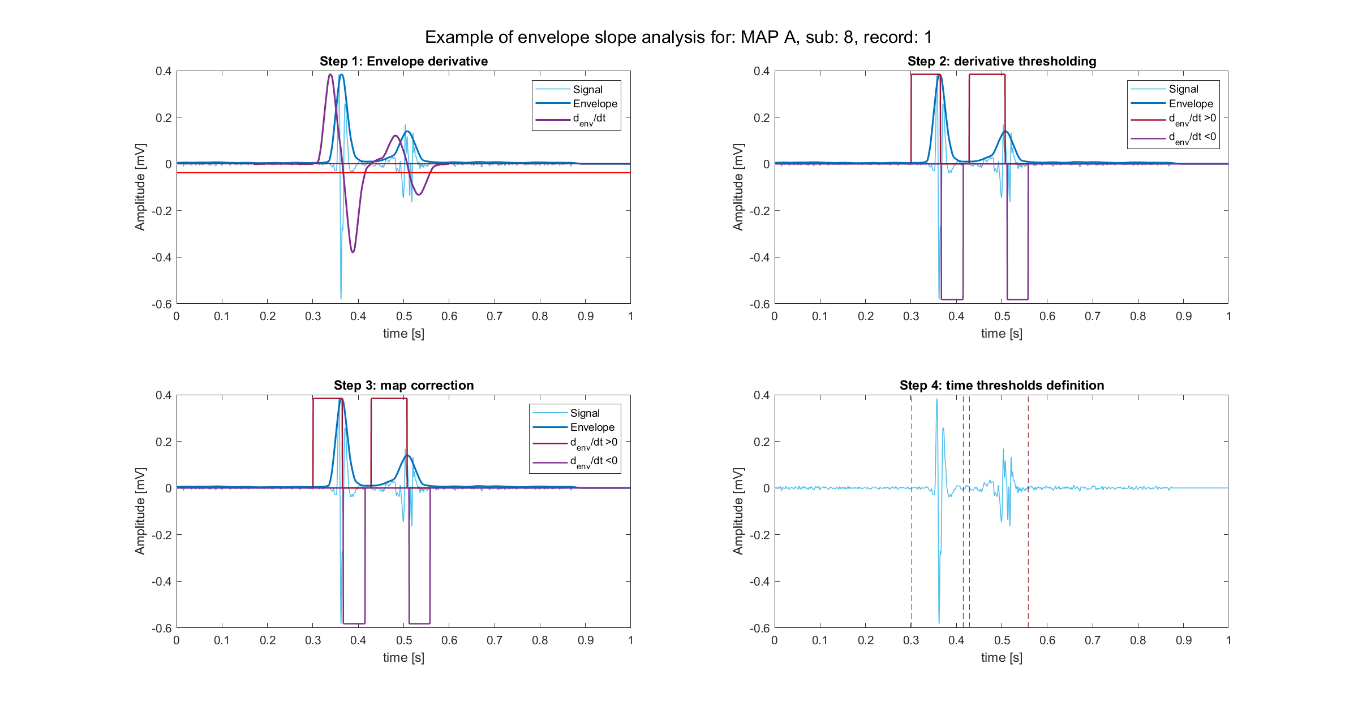
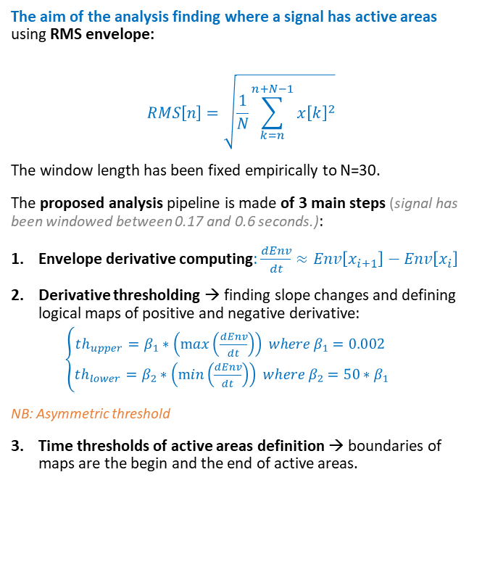
Envelope definition and peak recognition
The aim of the analysis finding where a signal has active areas using RMS envelope:
$$RMS\left[n\right]=\sqrt{\frac{1}{N}\sum_{k=n}^{n+N−1}{x{\left[k\right]}^{2}}}$$
The window length has been fixed empirically to N=30.
The proposed analysis pipeline is made of 3 main steps (signal has been windowed between 0.17 and 0.6 seconds.):
Envelope derivative computing: $\frac{dEnv}{dt}≈Env\left[x_{i+1}\right]−Env\left[x_{i}\right]$
Derivative thresholding → finding slope changes and defining logical maps of positive and negative derivative:
$\left\{\begin{aligned}th_{upper}=β_{1}∗\left(\max\left(\frac{dEnv}{dt}\right)\right) where β_{1}=0.002 \\ th_{lower}=β_{2}∗\left(\min\left(\frac{dEnv}{dt}\right)\right) where β_{2}=50∗β_{1}\end{aligned}\right.$
NB: Asymmetric threshold
Time thresholds of active areas definition → boundaries of maps are the begin and the end of active areas.

Slide 5
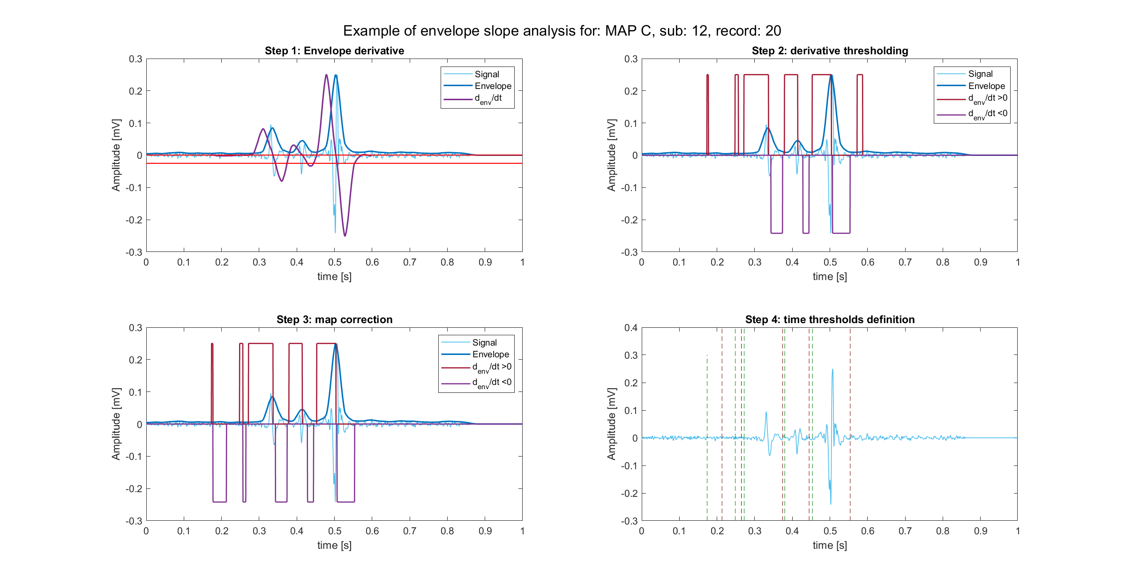
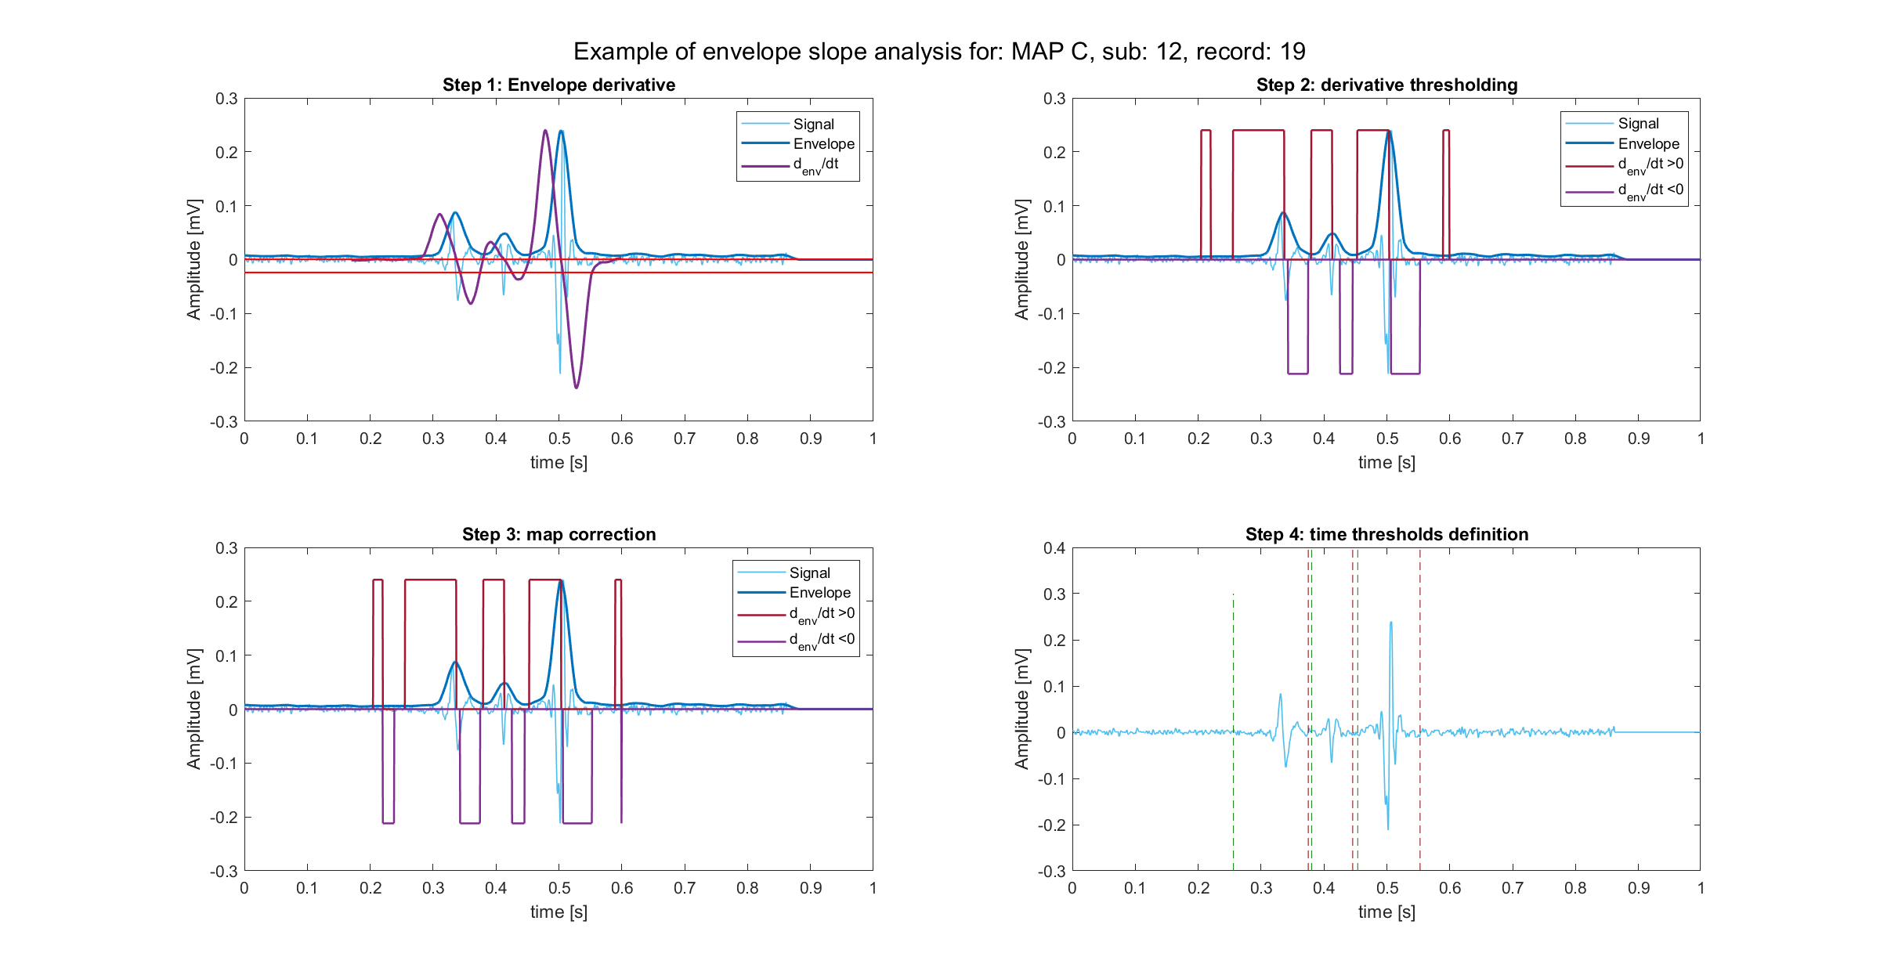
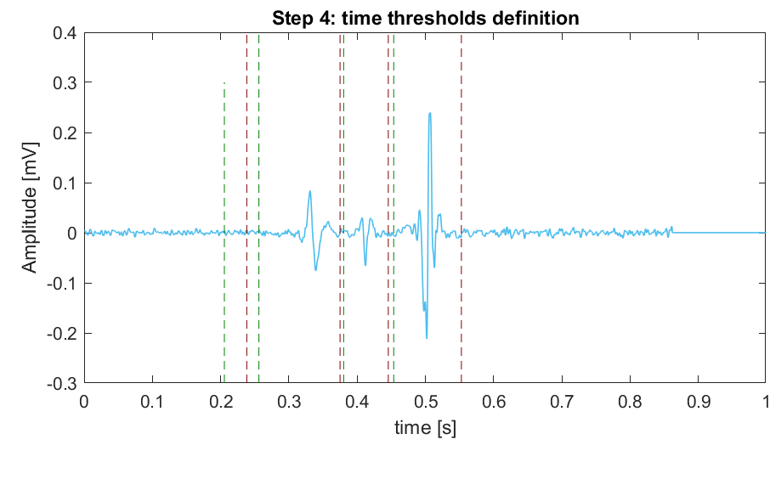
The over-detecting problem
This pipeline has, by building, a peculiarity: active areas are found in superabundance. In fact:
high sensibility of the upper threshold → even noise could be detected as peak → even noise can be seen as “active area”
In other words, this pipeline works with the logic “the higher, the better”. A decisional rule is necessary.
Thus:
True active areas are the ones associated to peaks higher than K=2.5 times the standard deviation of the signal.
After time thresholds cleaning

Slide 6
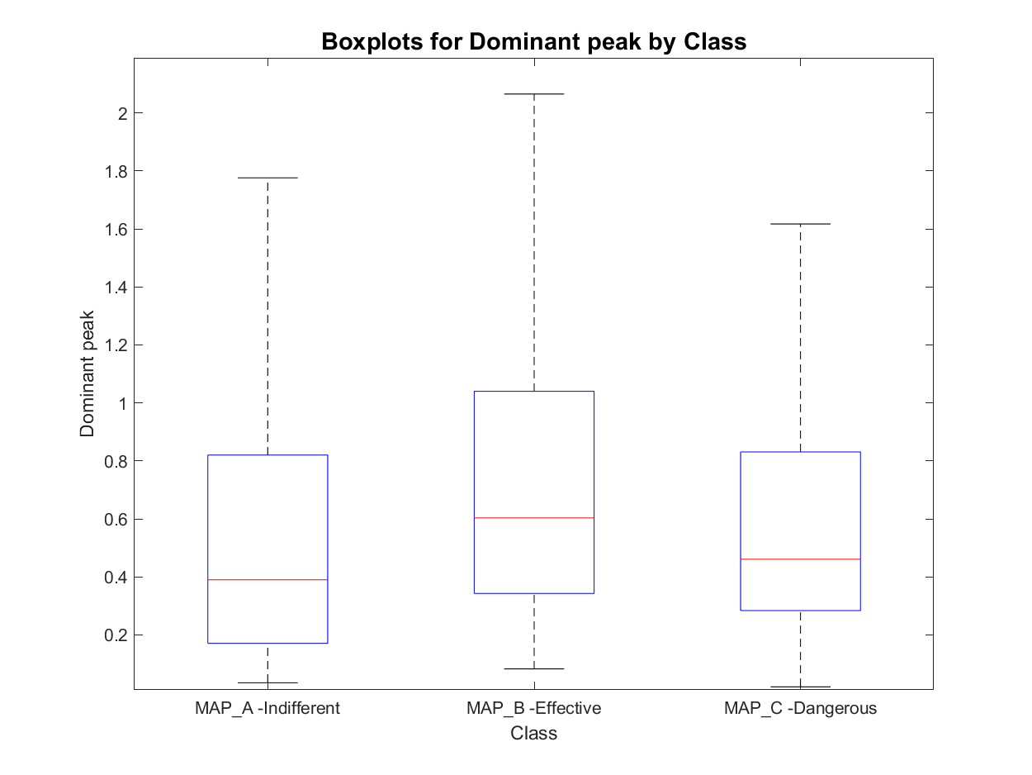
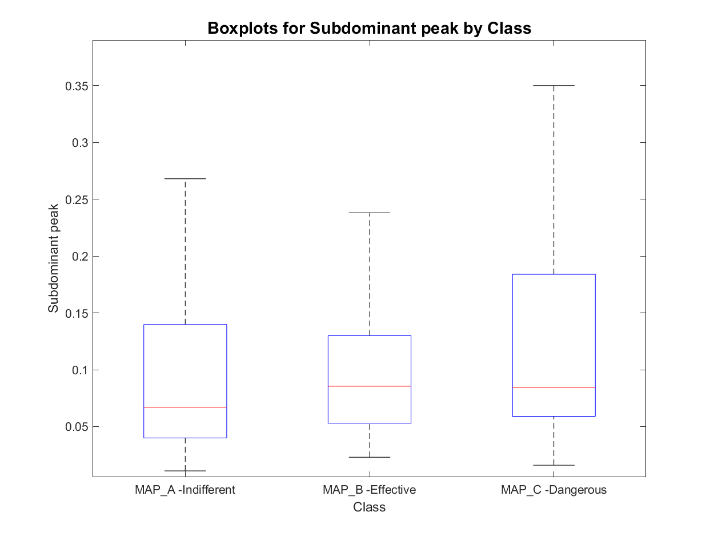
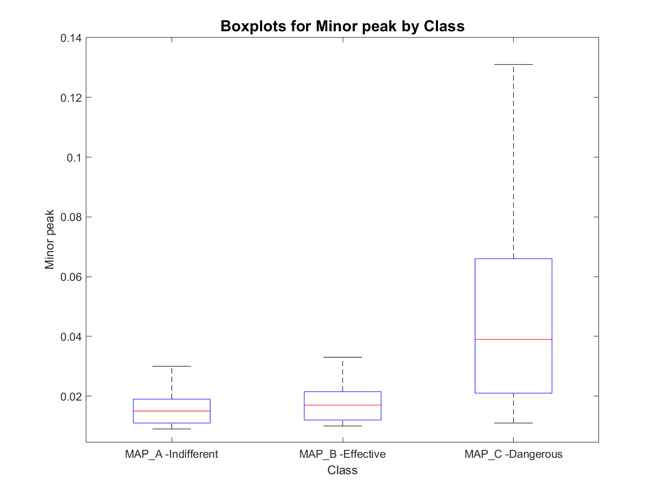
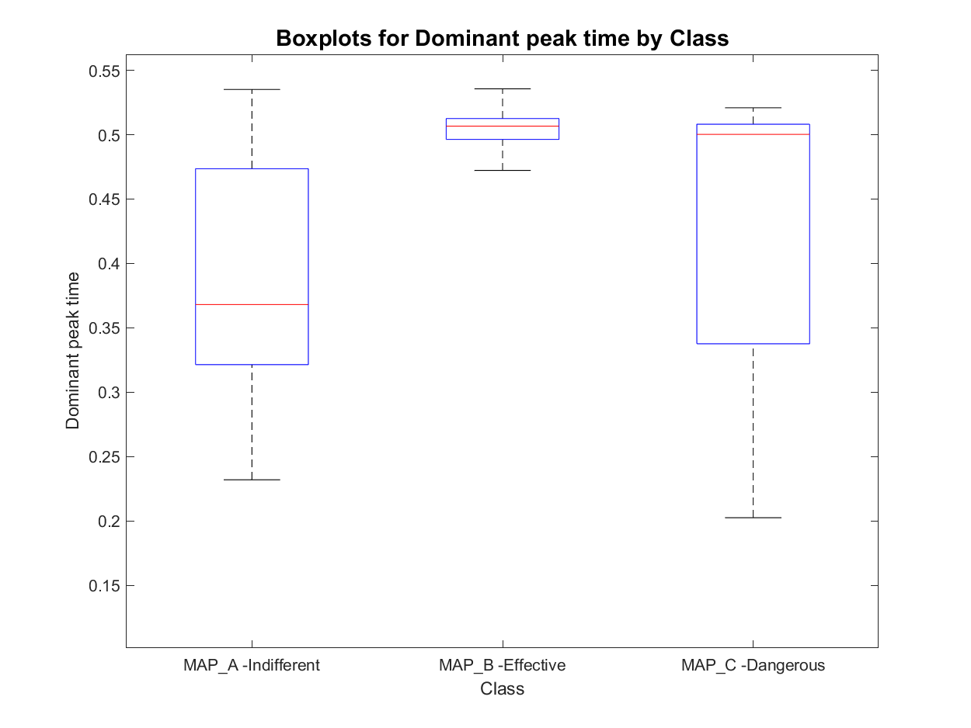
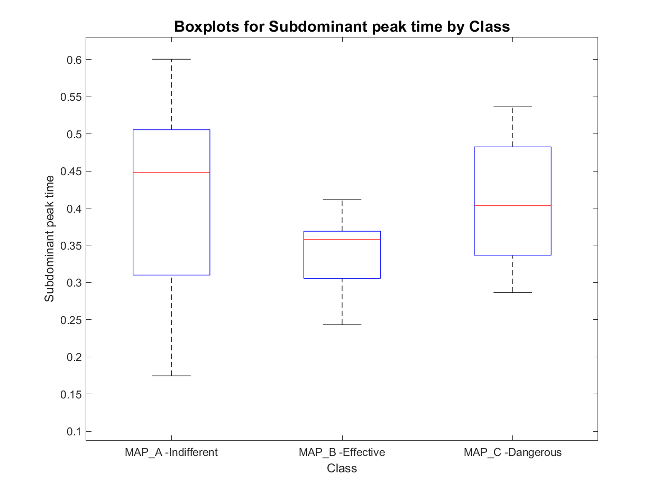
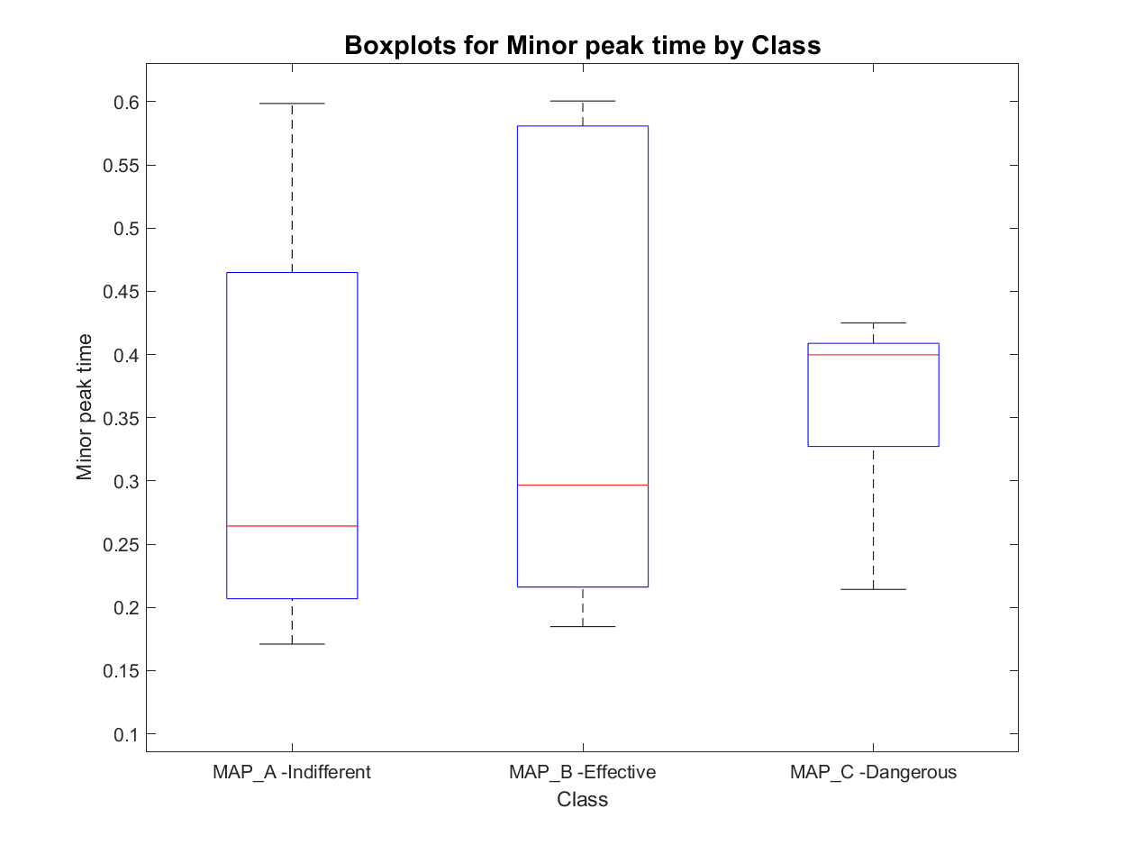
Features set 1.1: signal peak in order of magnitude
MAP_A has:
- 8 signals with one active area
- 452 signals with two active areas
- 180 signals with three active areas
- 23 signals with more than three active areas
total : 640
MAP_B has:
- 0 signals with one active area
- 67 signals with two active areas
- 26 signals with three active areas
- 1 signals with more than three active areas
total : 93
MAP_C has:
- 0 signals with one active area
- 20 signals with two active areas
- 62 signals with three active areas
- 8 signals with more than three active areas
total : 82
Prior Knowledge
Unclear behaviour

Slide 7
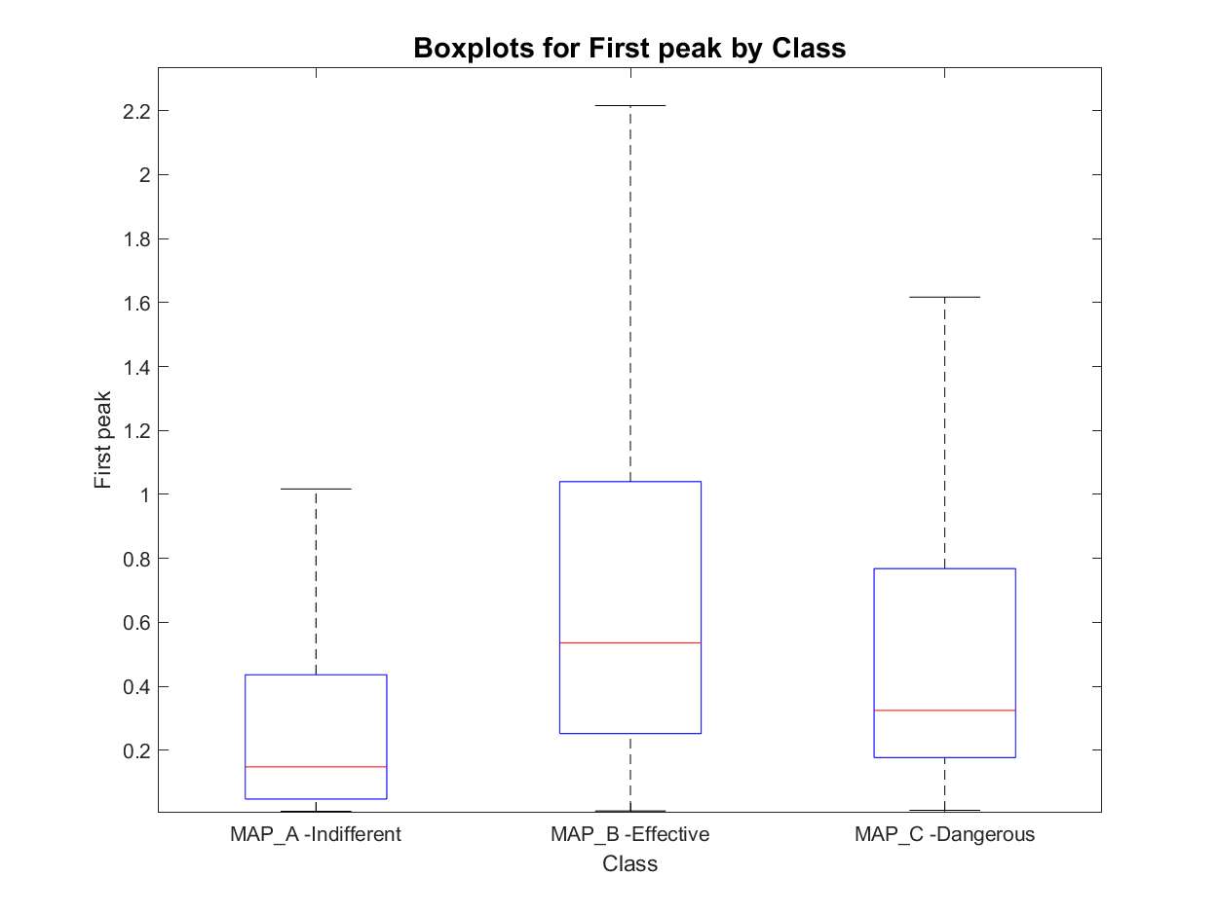
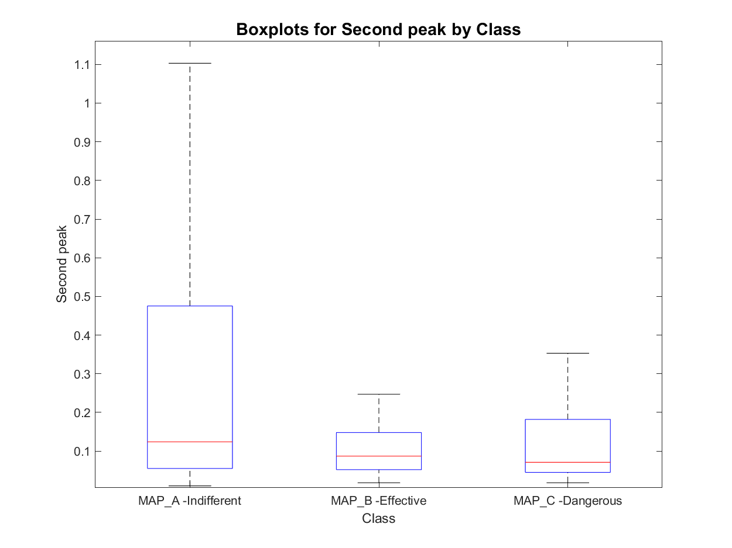
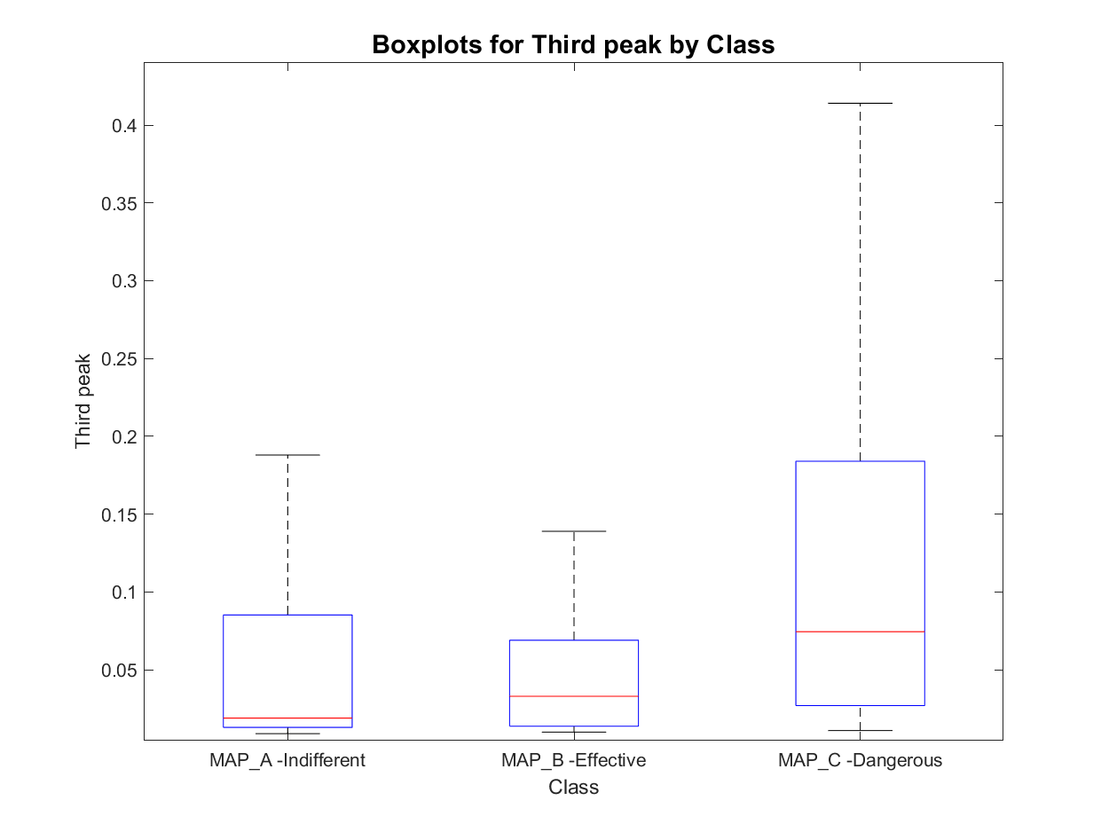
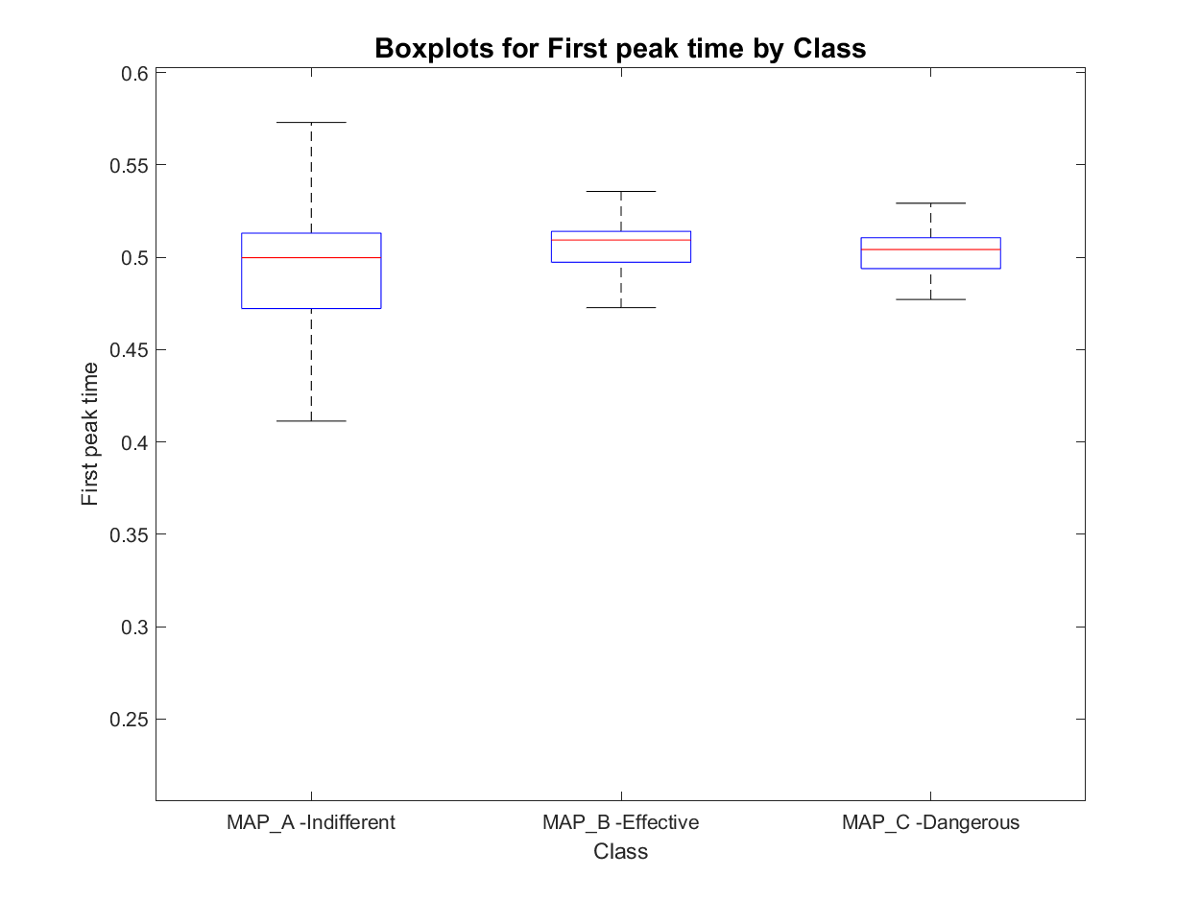
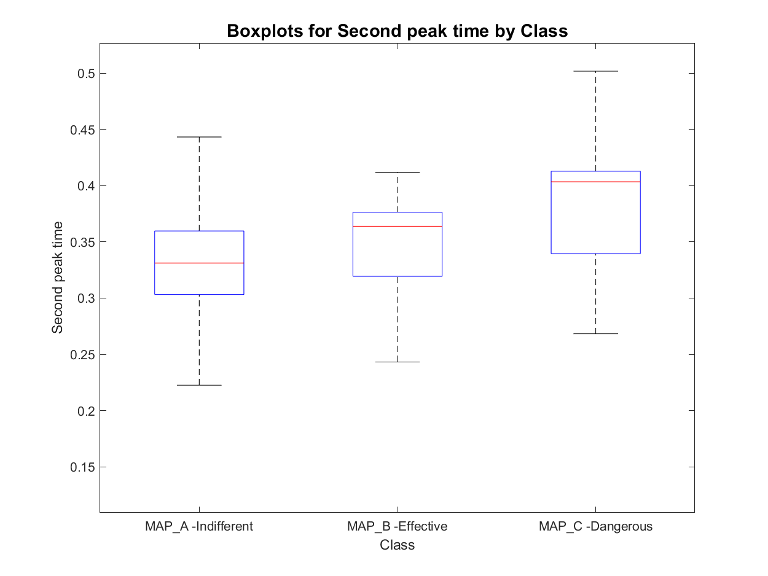
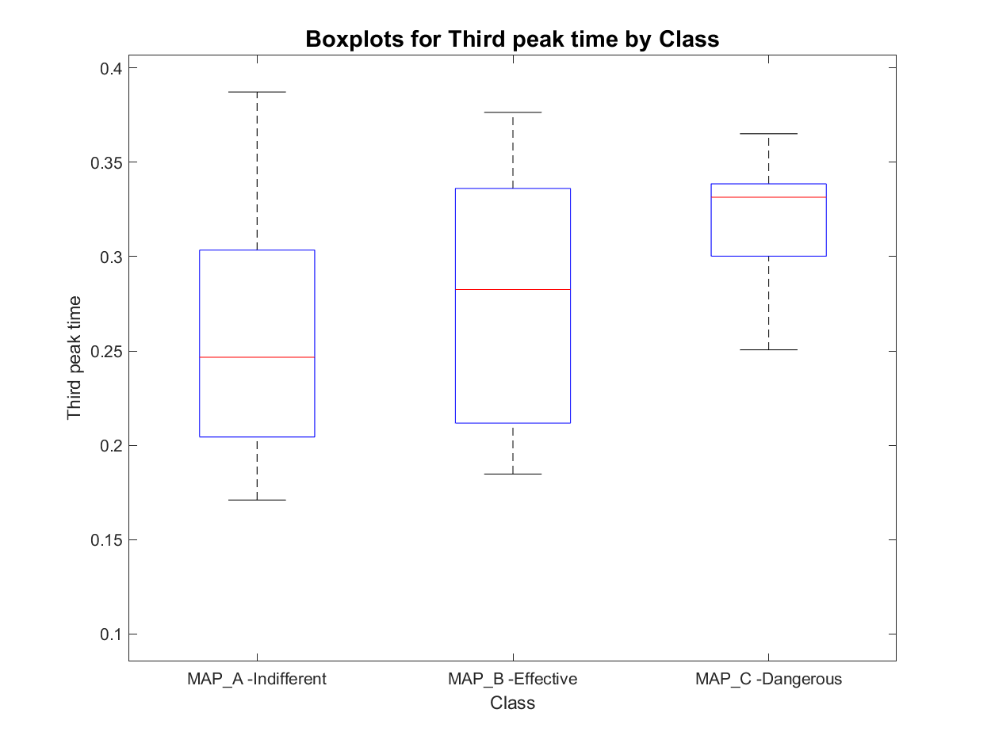
Features set 1.2: Signal peaks in order of time occurrence
MAP_A has:
- 8 signals with one active area
- 452 signals with two active areas
- 180 signals with three active areas
- 23 signals with more than three active areas
total : 640
MAP_B has:
- 0 signals with one active area
- 67 signals with two active areas
- 26 signals with three active areas
- 1 signals with more than three active areas
total : 93
MAP_C has:
- 0 signals with one active area
- 20 signals with two active areas
- 62 signals with three active areas
- 8 signals with more than three active areas
total : 82

Slide 8
Active area analysis: entire set of features
Starting from active areas definition other features have been computed:
Number of active area detected
Signal and envelope peaks absolute values
In order of magnitude: Dominant, Subdominant, Minor peak value and time (6 features + 6 features from envelope signal)
In order of occurrence: First, Second, Third peak value and time (6 features + 6 features from envelope signal)
Duration of active signal
Silent phase within signal duration
Ratios between single features
Subdominant to major,
Minor to subdominant
Atrial to ventricular peak ratio
Atrial to ventricular peak time ratio
Number of active areas on duration ratio
Silent phase on duration ratio
Number of peaks on duration ratio

Slide 9
Outline
Feature extraction
Envelope features
Template matching features
Short time Fourier transformation features
Classification
Knowledge based classifier: recap
Improved Knowledge based classifier
Tree classifier: whole set of features optimal subset of features
Conclusions

Slide 10
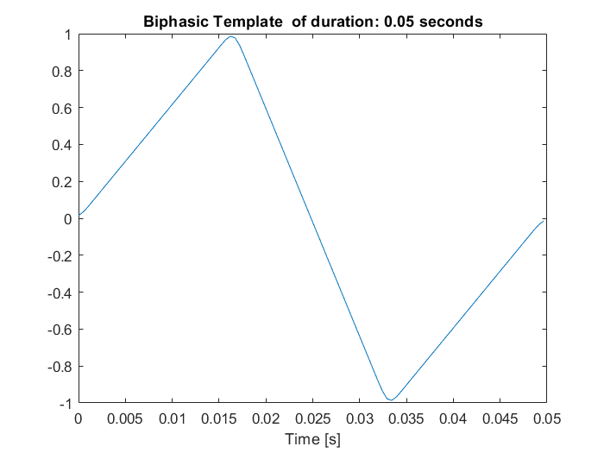
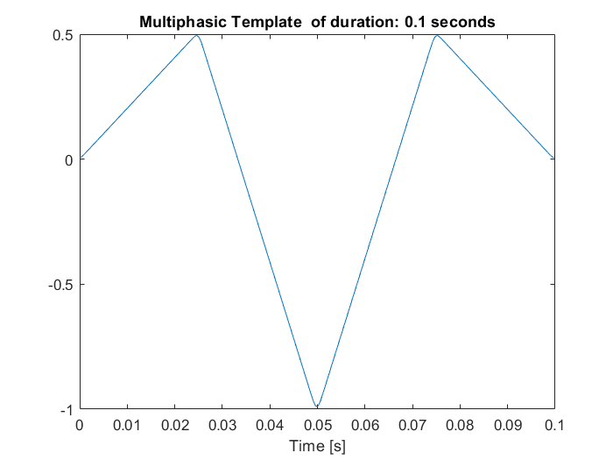
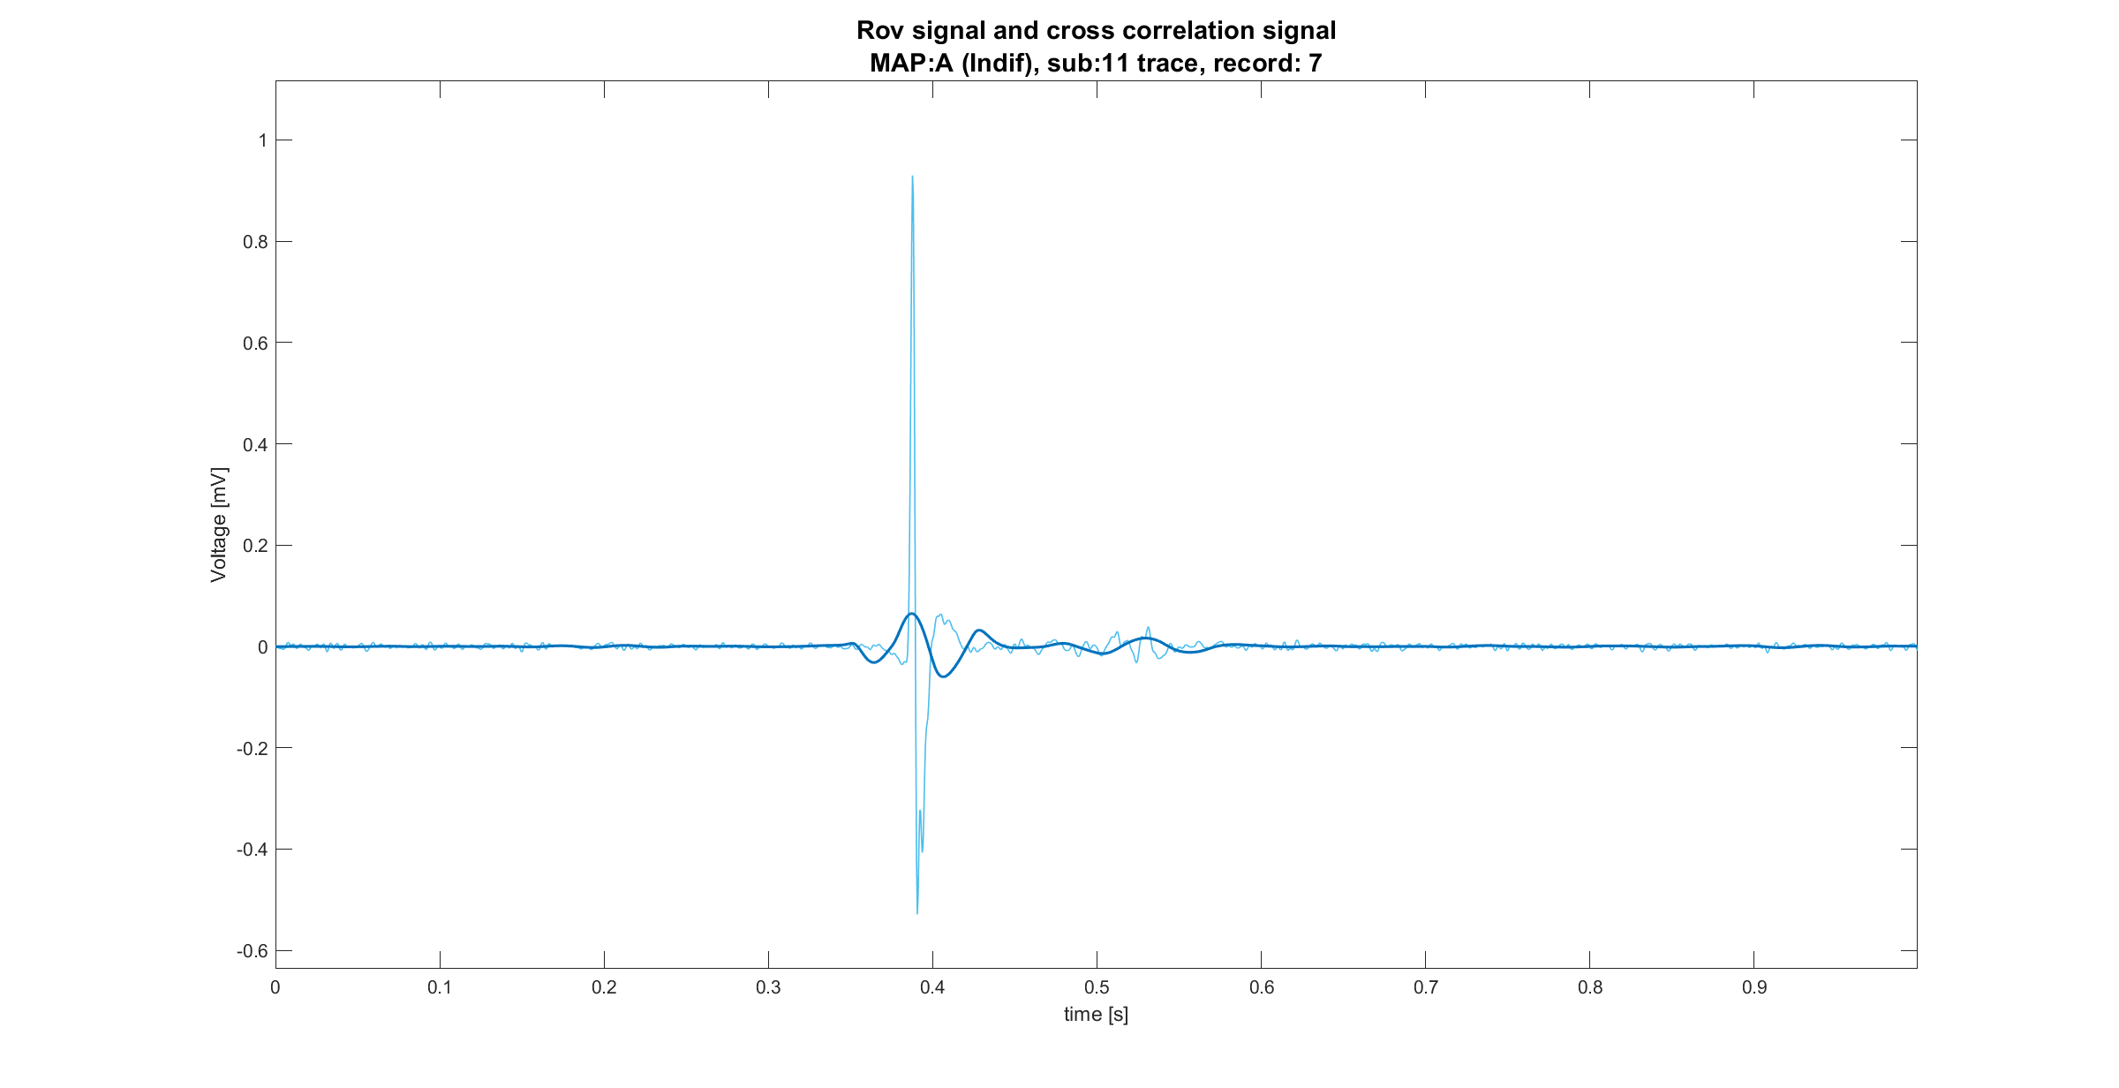
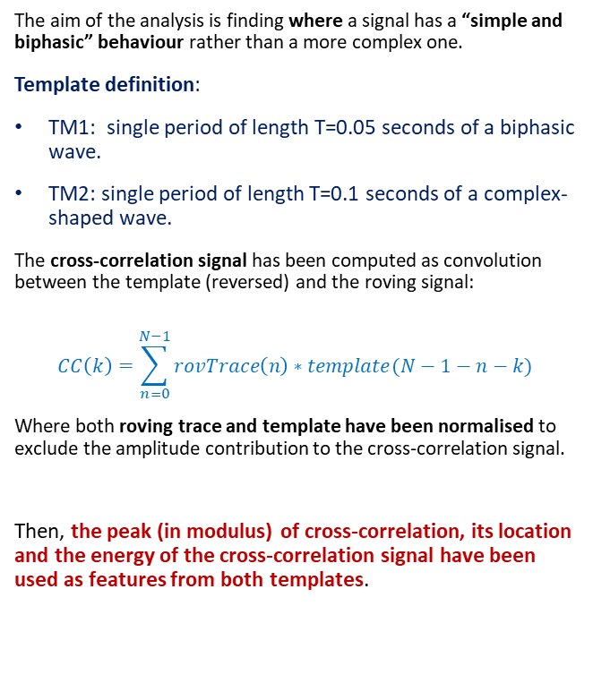

Template matching definition
The aim of the analysis is finding where a signal has a “simple and biphasic” behaviour rather than a more complex one.
Template definition:
TM1: single period of length T=0.05 seconds of a biphasic wave.
TM2: single period of length T=0.1 seconds of a complex-shaped wave.
The cross-correlation signal has been computed as convolution between the template (reversed) and the roving signal:
$$CC\left(k\right)=\sum_{n=0}^{N−1}{rovTrace\left(n\right)∗template(N−1−n−k)}$$
Where both roving trace and template have been normalised to exclude the amplitude contribution to the cross-correlation signal.
Then, the peak (in modulus) of cross-correlation, its location and the energy of the cross-correlation signal have been used as features from both templates.
$$(peak,t_{peak})$$

Slide 11
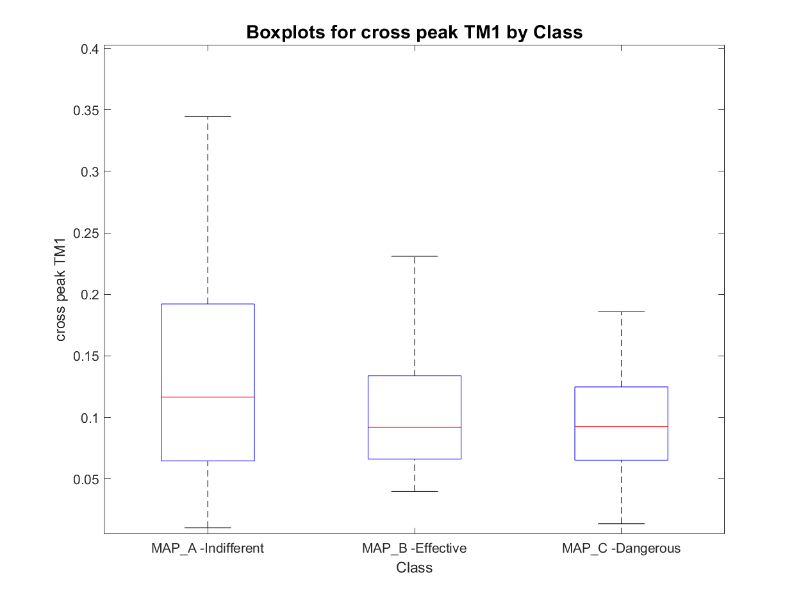
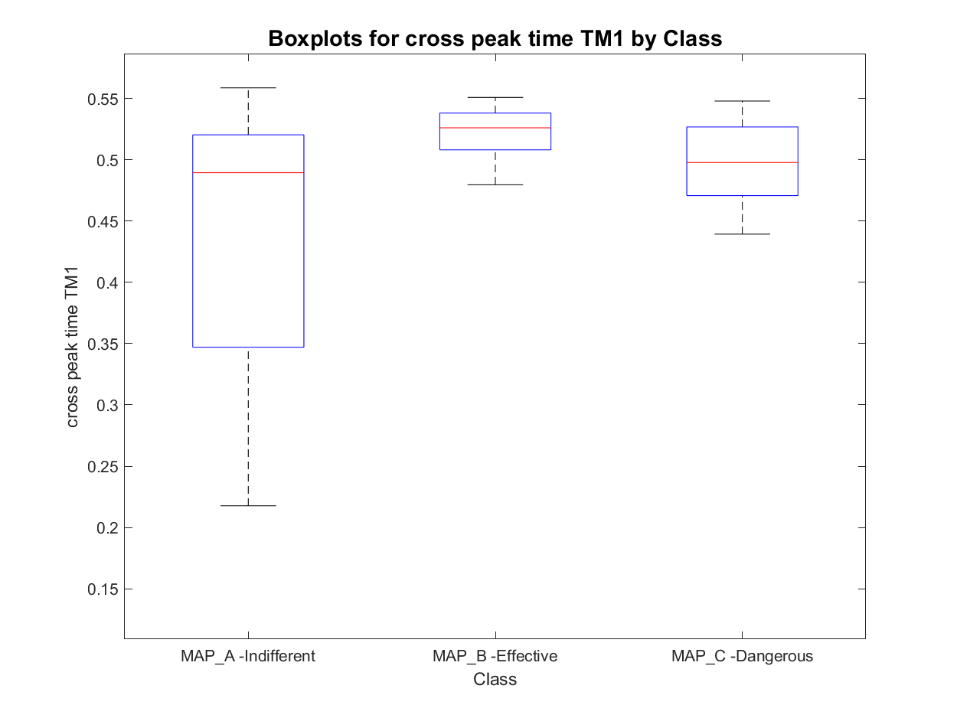
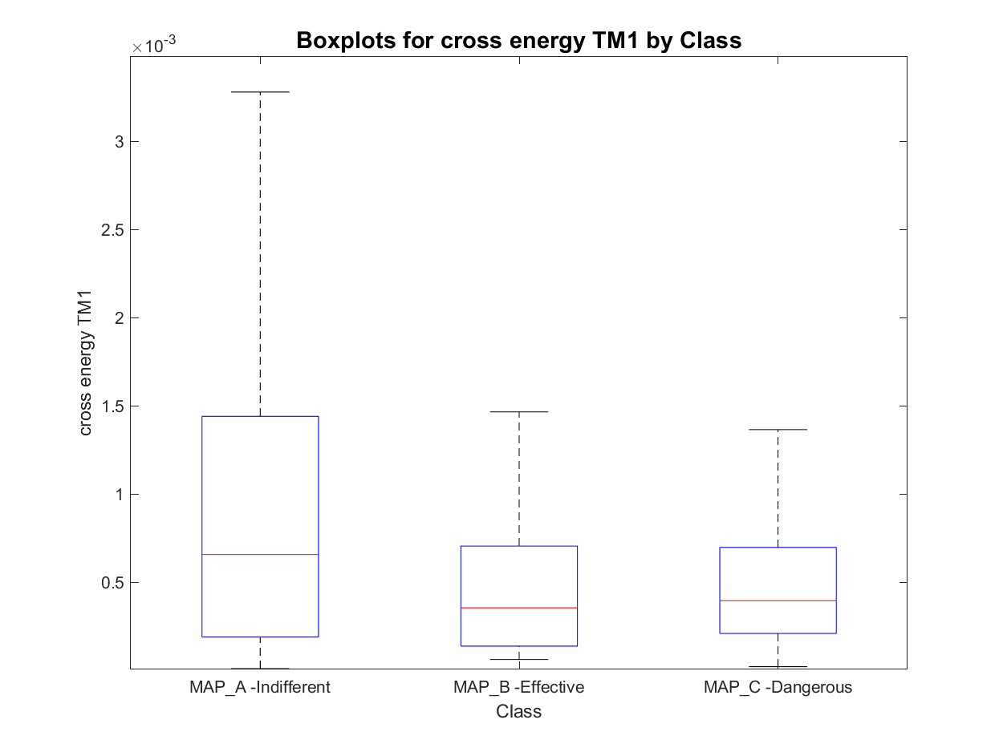
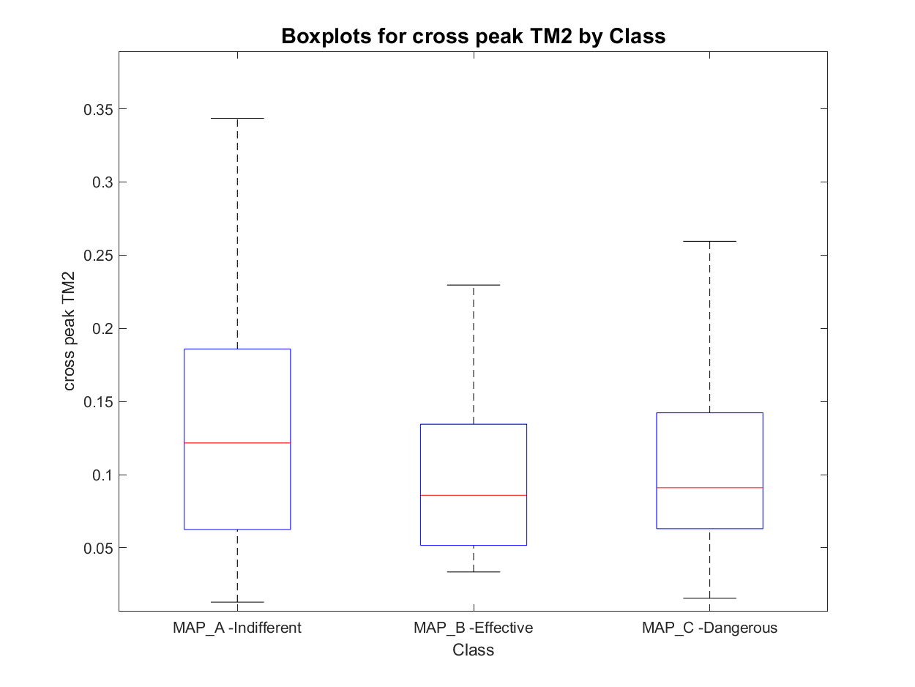
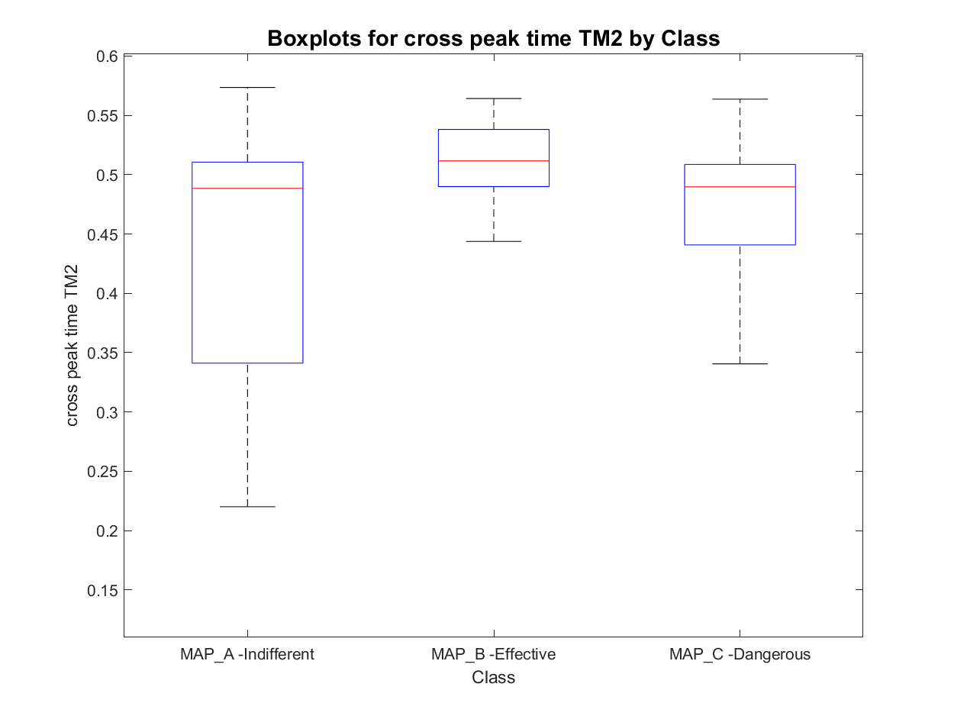
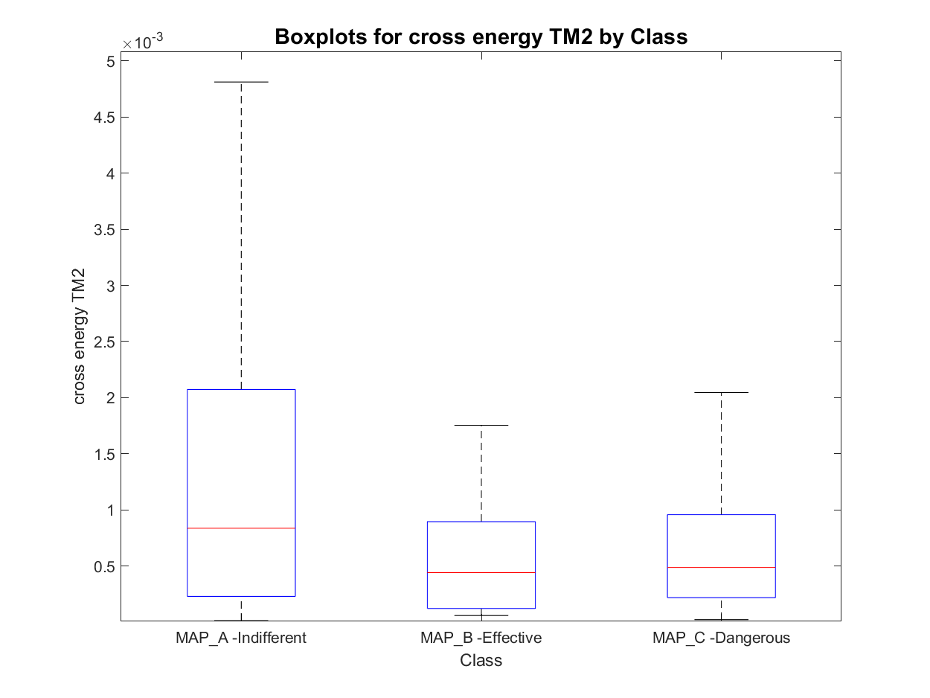
Features set 2: Template Matching features
MAP_A has:
- 8 signals with one active area
- 452 signals with two active areas
- 180 signals with three active areas
- 23 signals with more than three active areas
total : 640
MAP_B has:
- 0 signals with one active area
- 67 signals with two active areas
- 26 signals with three active areas
- 1 signals with more than three active areas
total : 93
MAP_C has:
- 0 signals with one active area
- 20 signals with two active areas
- 62 signals with three active areas
- 8 signals with more than three active areas
total : 82
TM1
TM2

Slide 12
Outline
Feature extraction
Envelope features
Template matching features
Short time Fourier transformation features
Classification
Knowledge based classifier: recap
Improved Knowledge based classifier
Tree classifier: whole set of features optimal subset of features
Conclusions

Slide 13
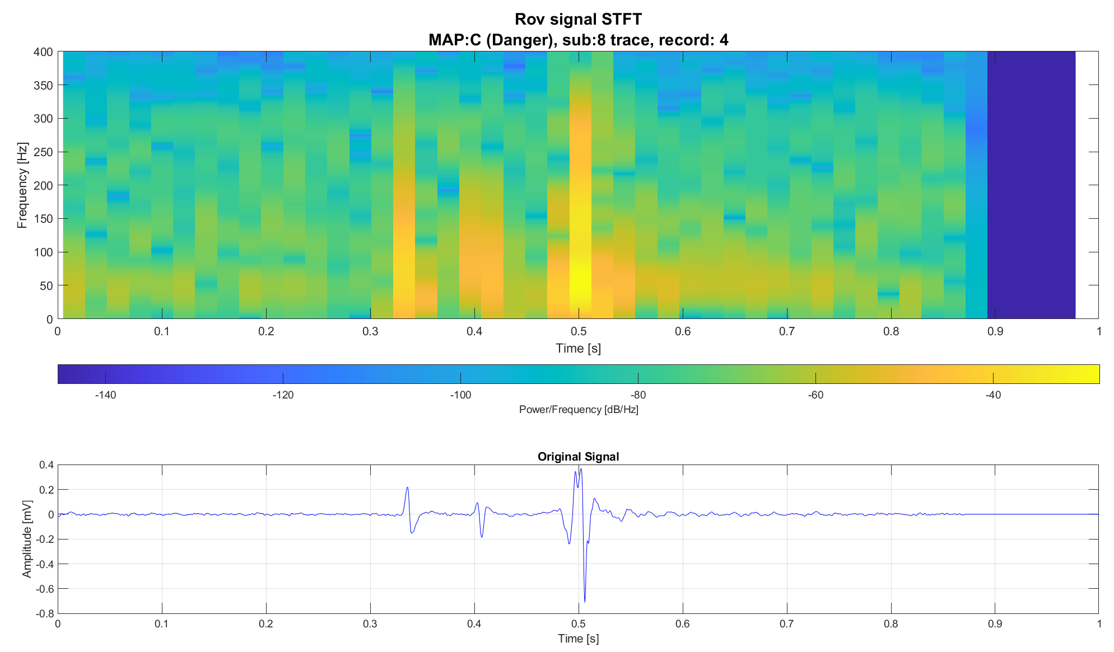
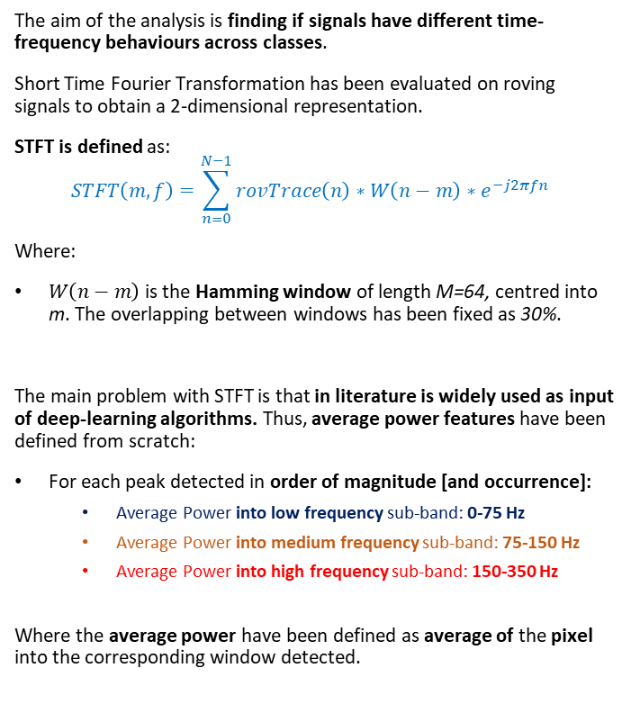
STFT definition
The aim of the analysis is finding if signals have different time-frequency behaviours across classes.
Short Time Fourier Transformation has been evaluated on roving signals to obtain a 2-dimensional representation.
STFT is defined as:
$$STFT\left(m,f\right)=\sum_{n=0}^{N−1}{rovTrace\left(n\right)∗W\left(n−m\right)∗e^{−j2πfn} }$$
Where:
$W\left(n−m\right)$ is the Hamming window of length M=64, centred into m. The overlapping between windows has been fixed as 30%.
The main problem with STFT is that in literature is widely used as input of deep-learning algorithms. Thus, average power features have been defined from scratch:
For each peak detected in order of magnitude [and occurrence]:
Average Power into low frequency sub-band: 0-75 Hz
Average Power into medium frequency sub-band: 75-150 Hz
Average Power into high frequency sub-band: 150-350 Hz
Where the average power have been defined as average of the pixel into the corresponding window detected.

Slide 14
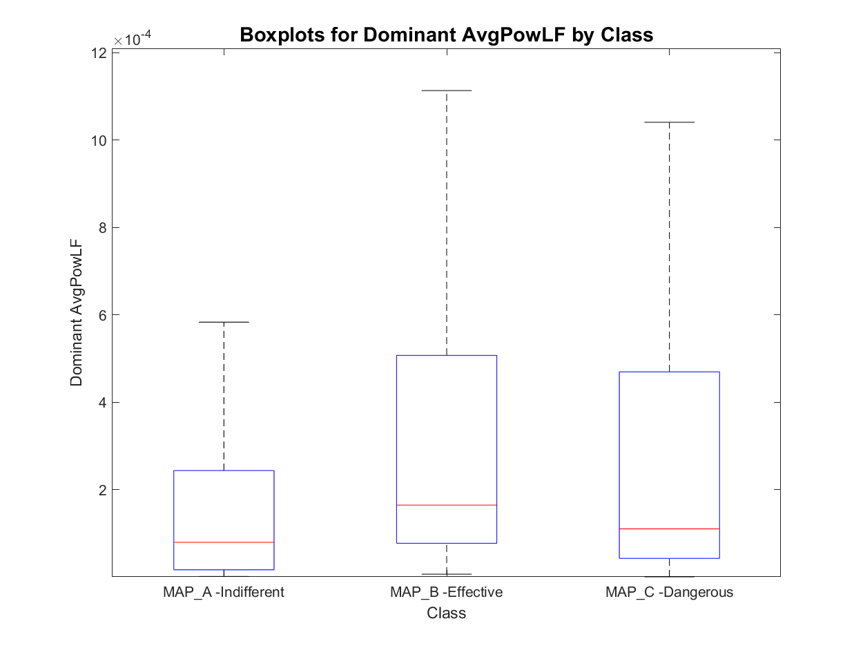
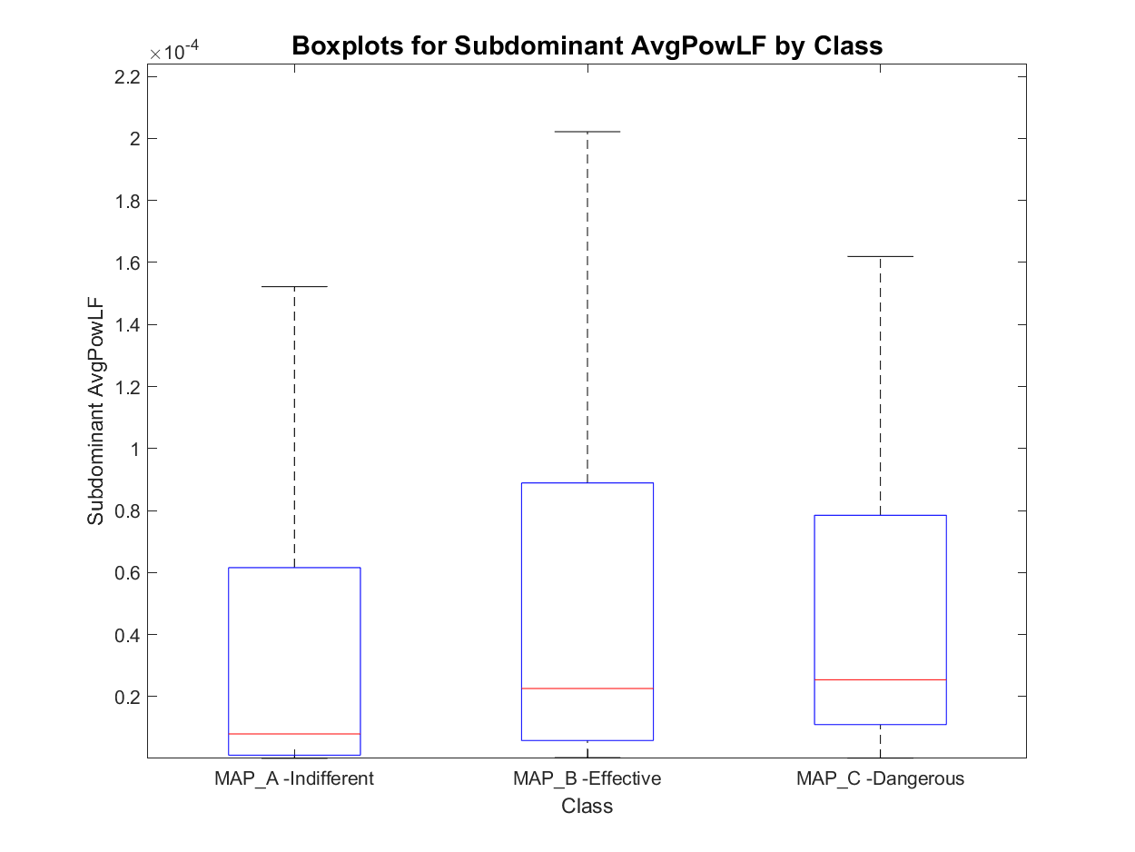
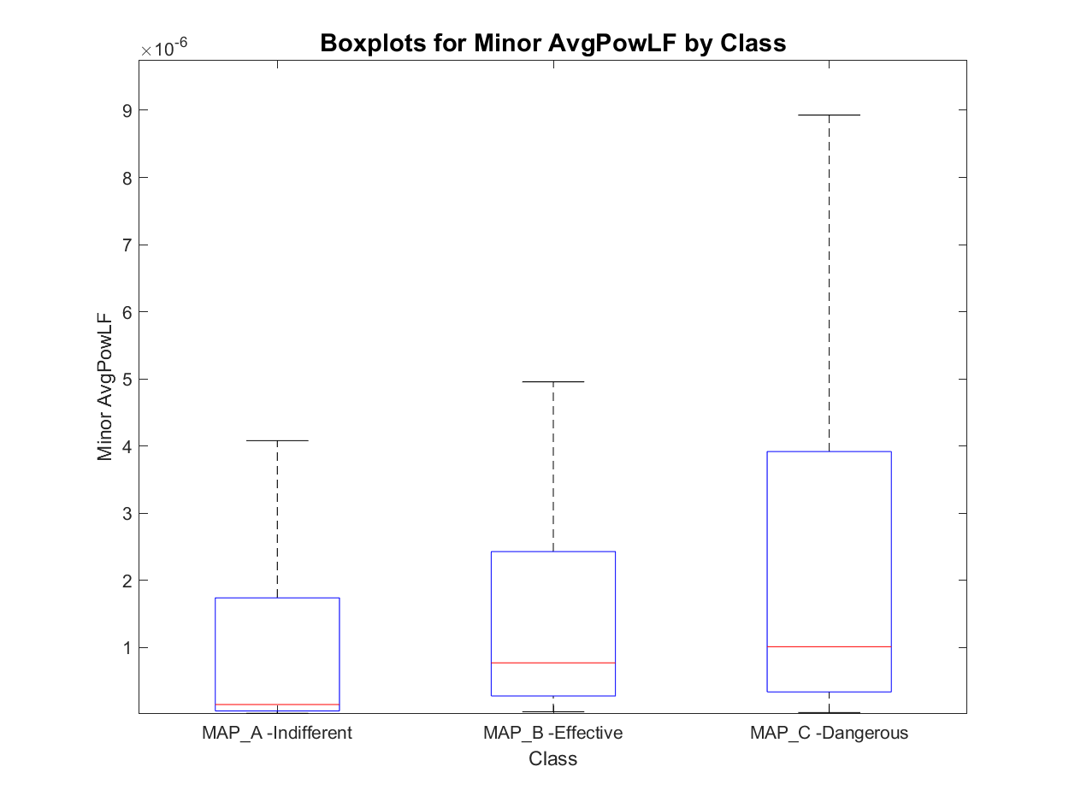
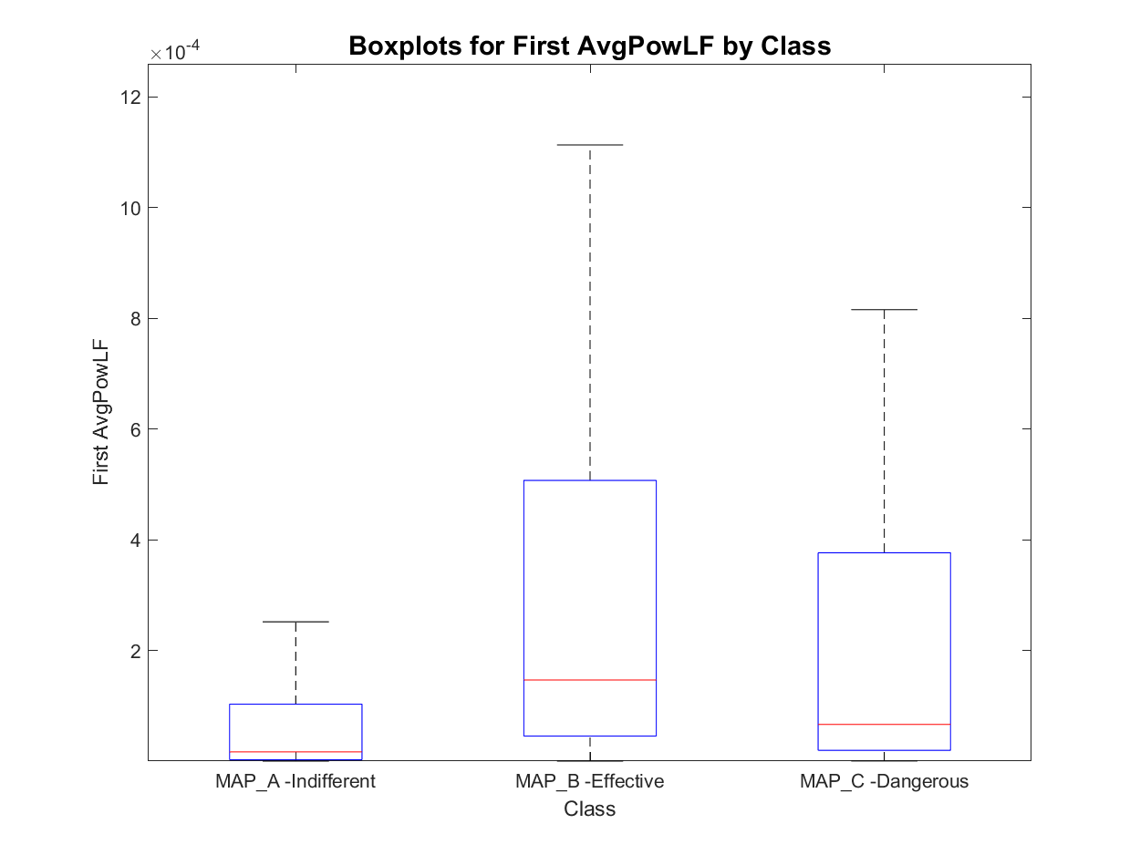
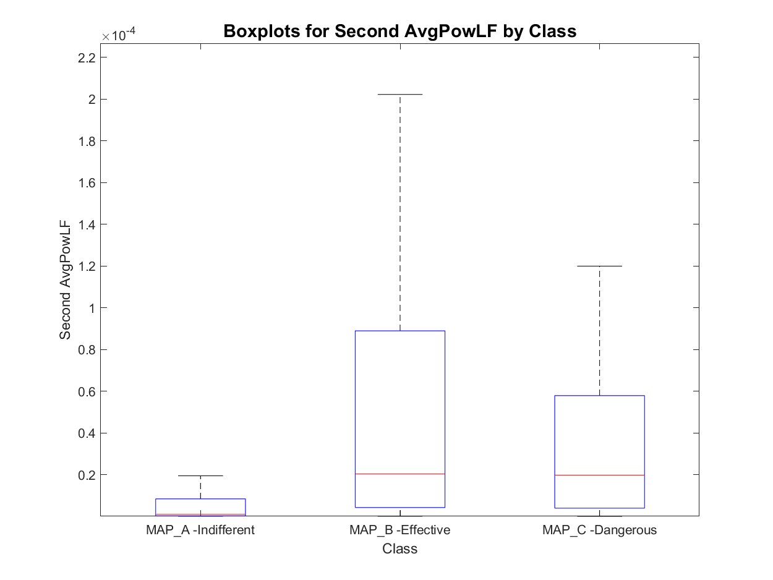
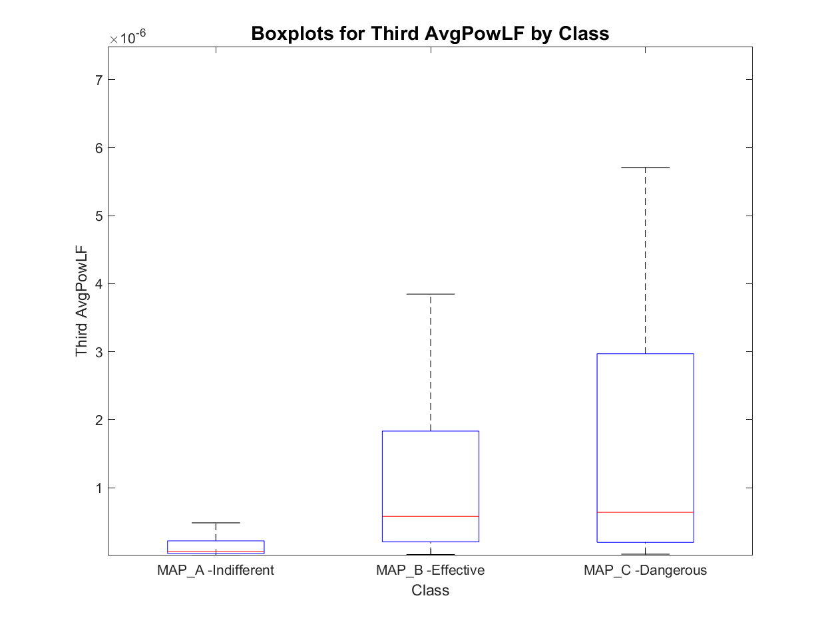
Features set 3.1: Avg LF Power of peaks
MAP_A has:
- 8 signals with one active area
- 452 signals with two active areas
- 180 signals with three active areas
- 23 signals with more than three active areas
total : 640
MAP_B has:
- 0 signals with one active area
- 67 signals with two active areas
- 26 signals with three active areas
- 1 signals with more than three active areas
total : 93
MAP_C has:
- 0 signals with one active area
- 20 signals with two active areas
- 62 signals with three active areas
- 8 signals with more than three active areas
total : 82
Order of magnitude
Order of occurrence

Slide 15
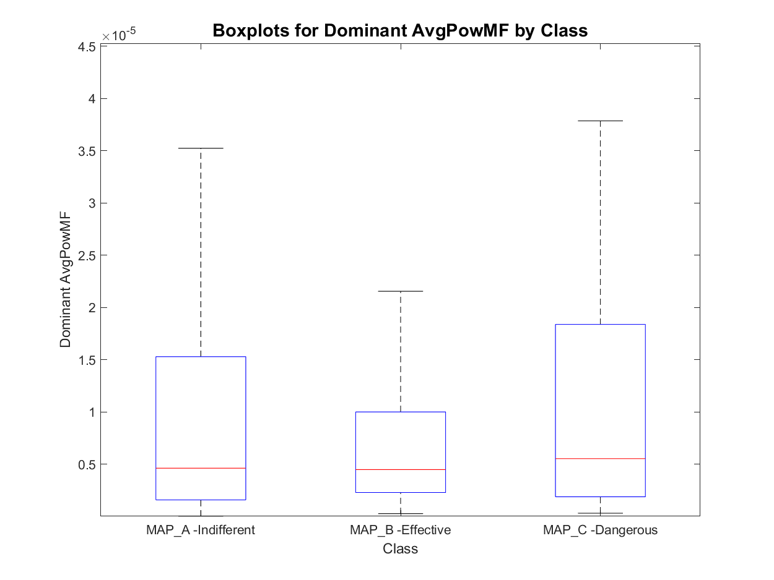
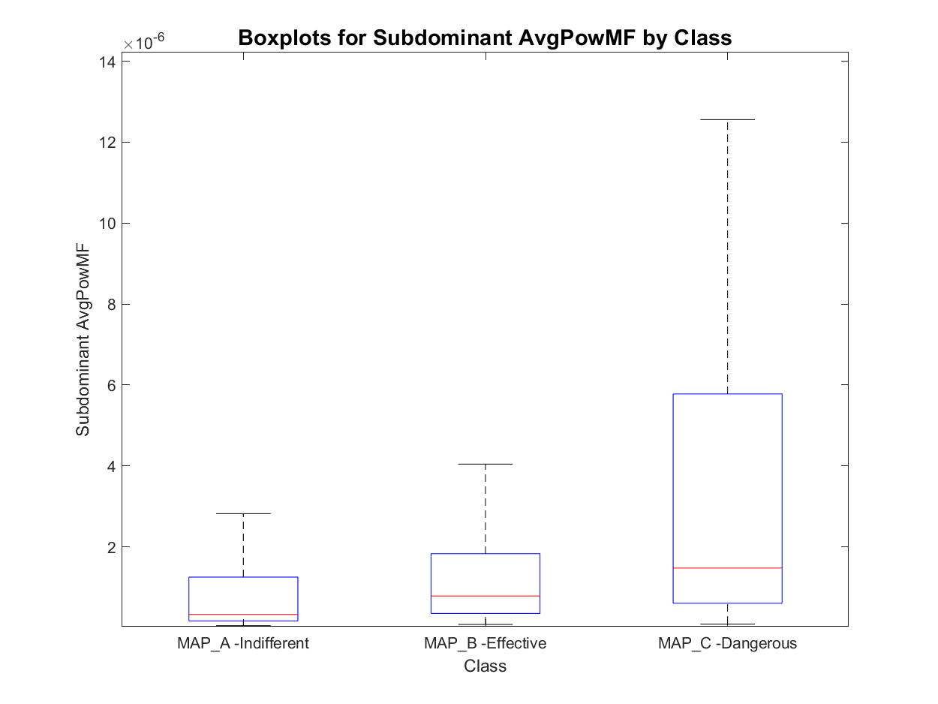
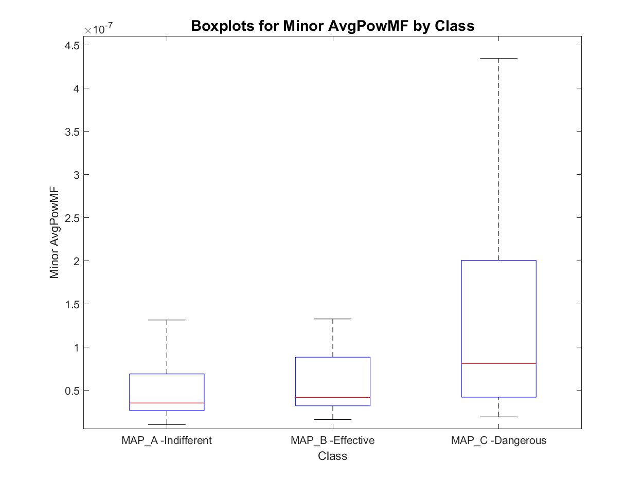
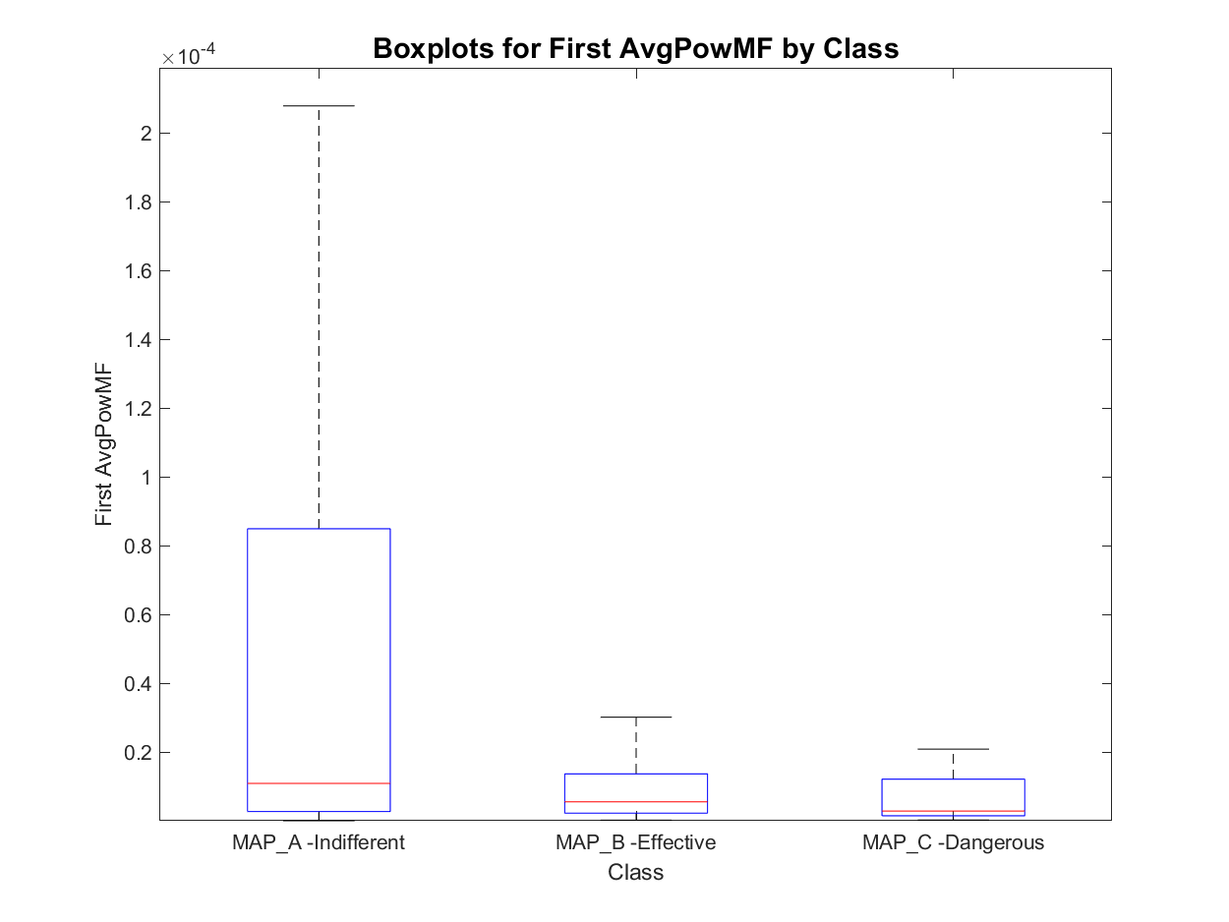
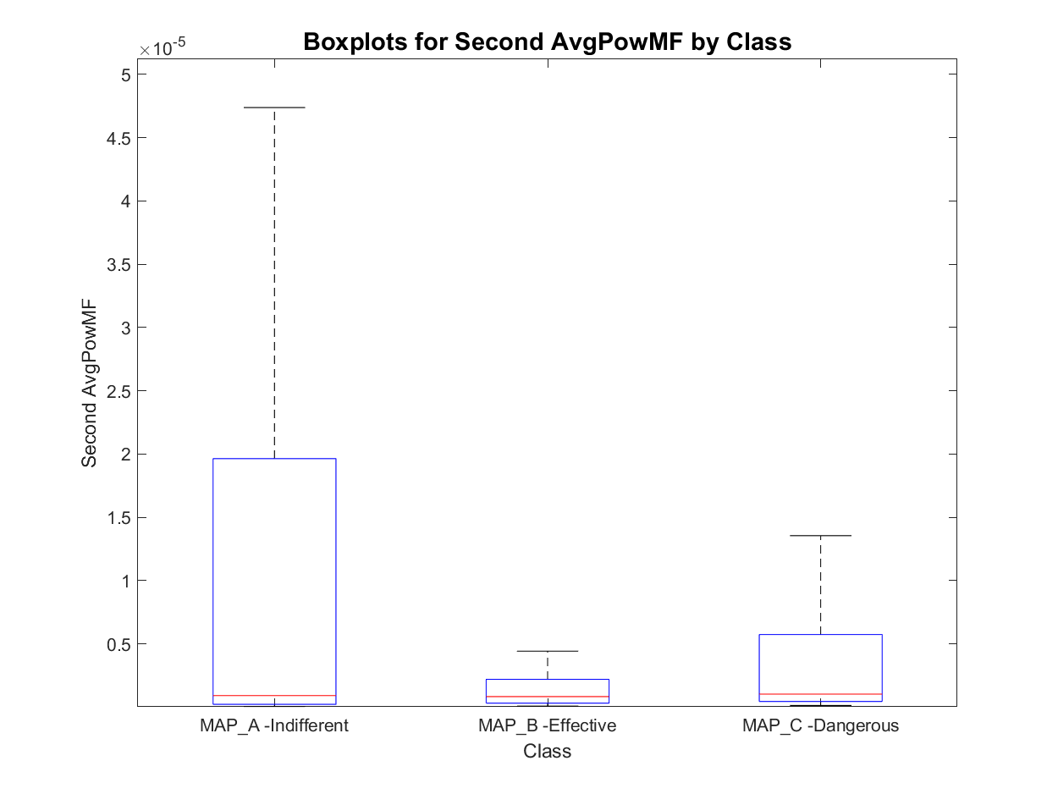
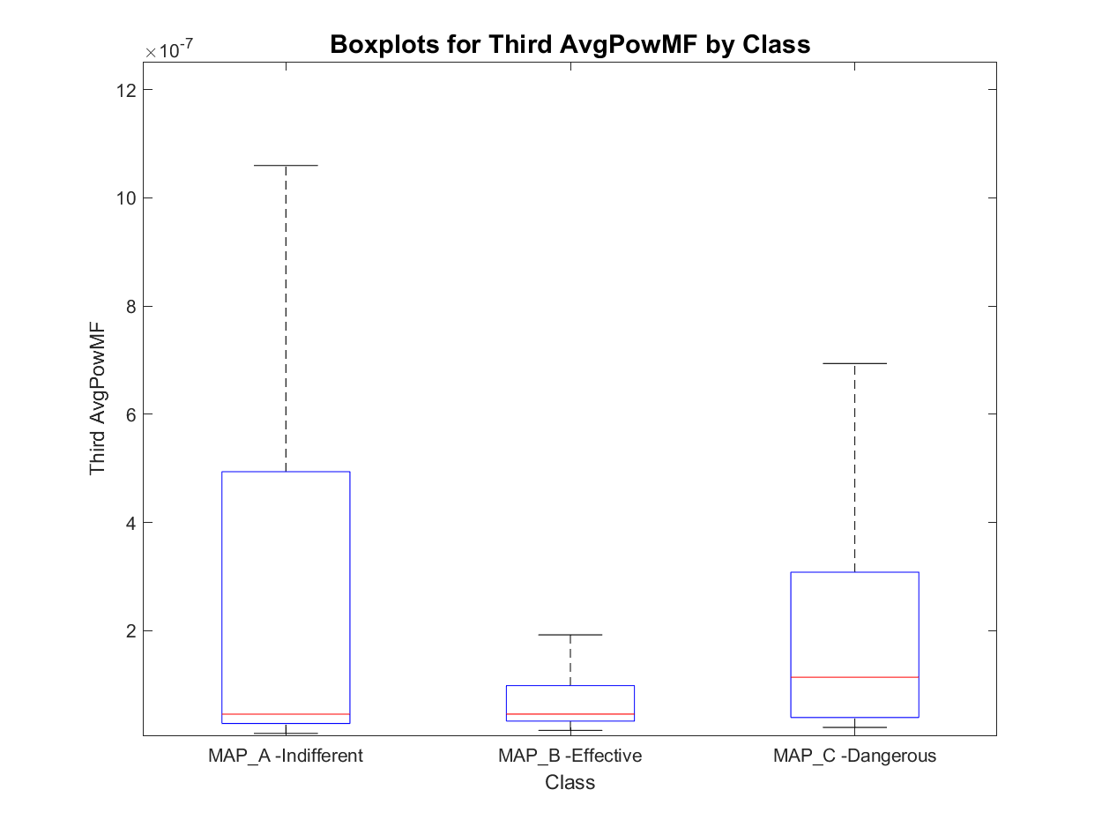
Features set 3.1: Avg MF Power of peaks
MAP_A has:
- 8 signals with one active area
- 452 signals with two active areas
- 180 signals with three active areas
- 23 signals with more than three active areas
total : 640
MAP_B has:
- 0 signals with one active area
- 67 signals with two active areas
- 26 signals with three active areas
- 1 signals with more than three active areas
total : 93
MAP_C has:
- 0 signals with one active area
- 20 signals with two active areas
- 62 signals with three active areas
- 8 signals with more than three active areas
total : 82
Order of magnitude
Order of occurrence

Slide 16
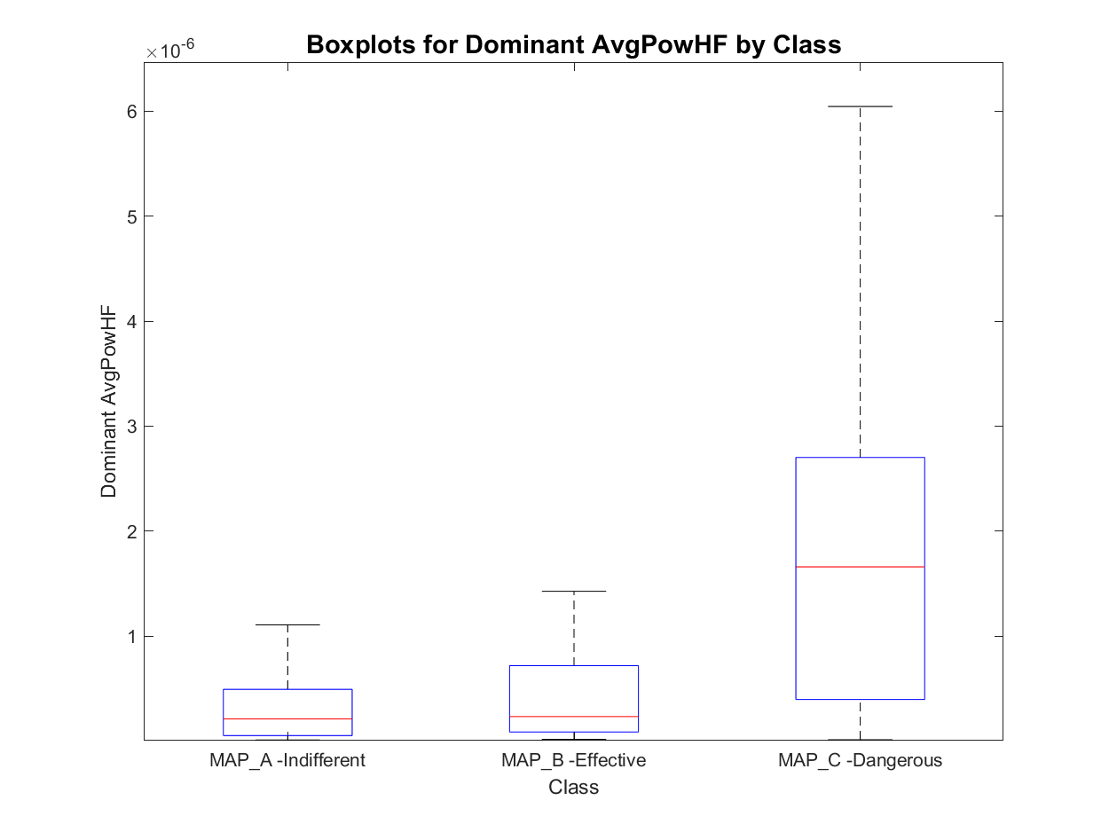
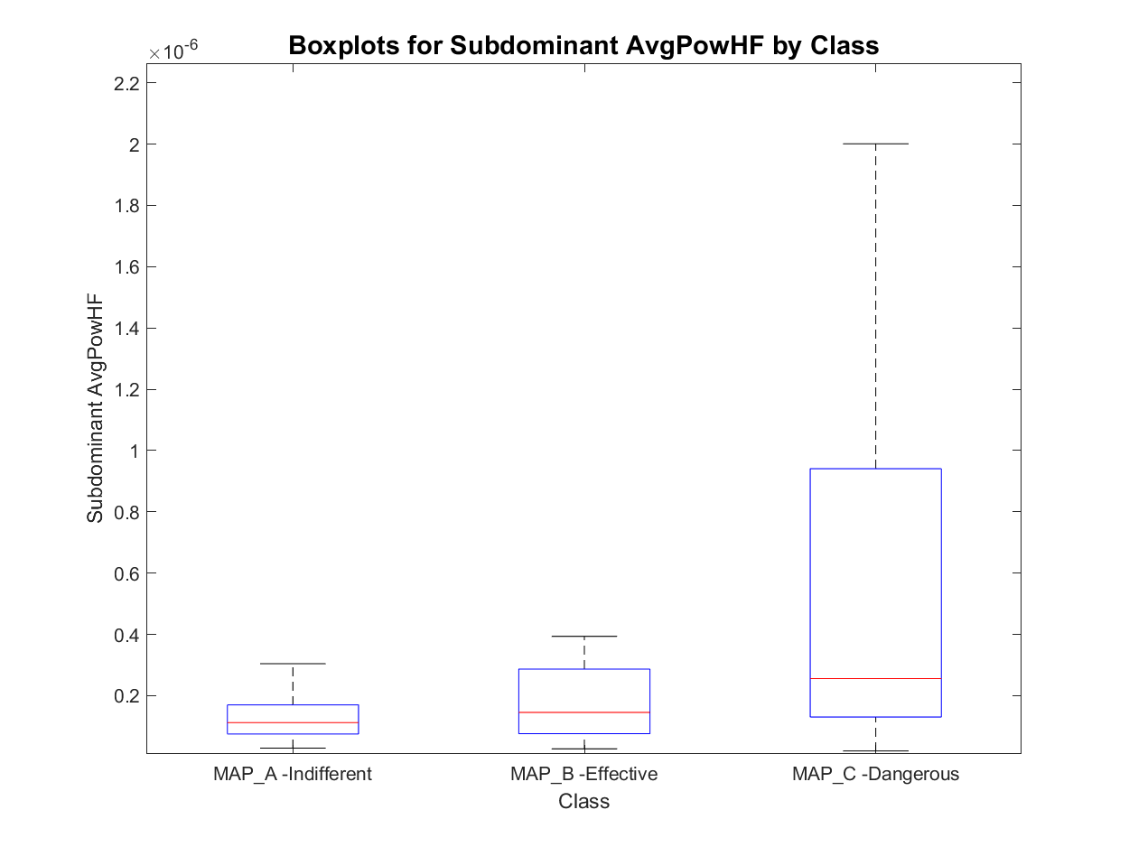
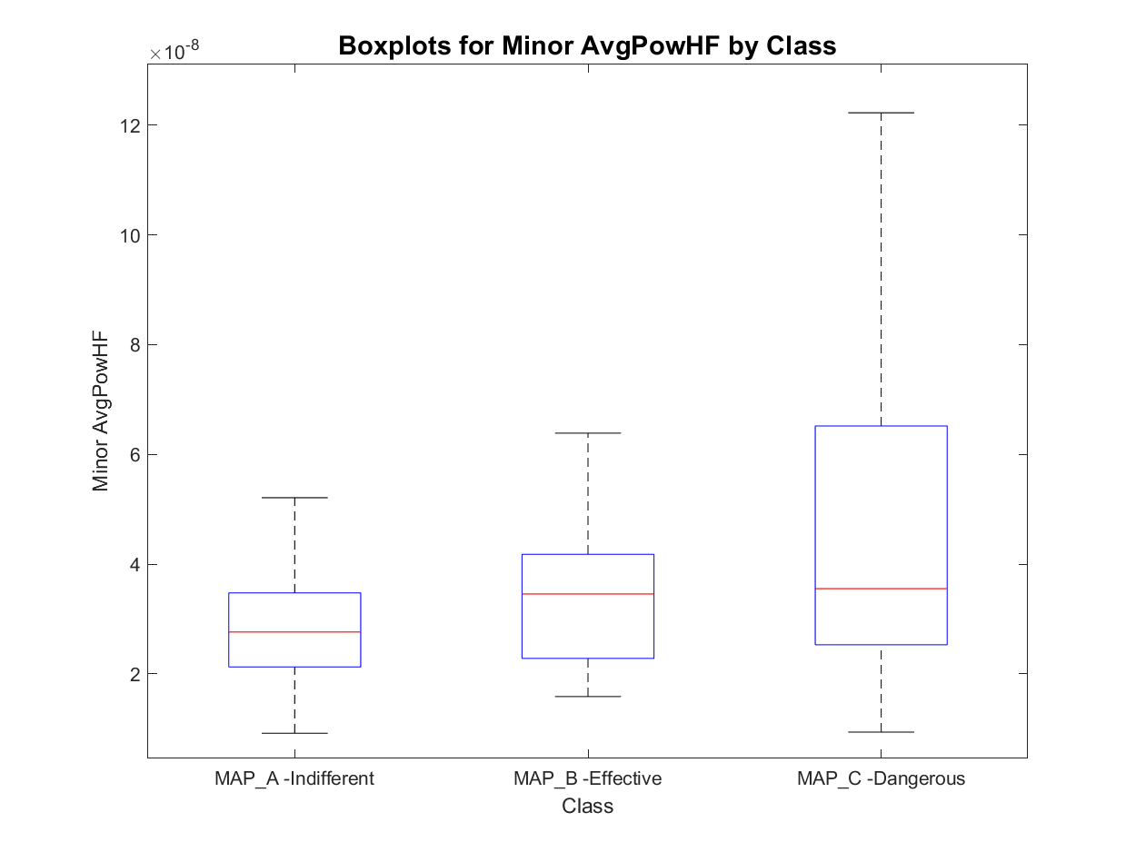
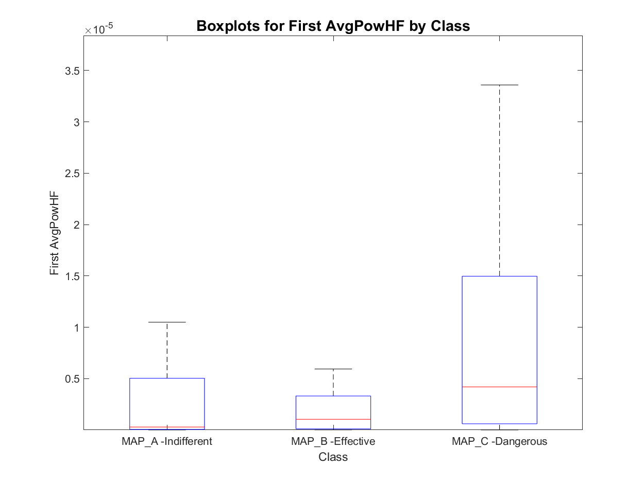
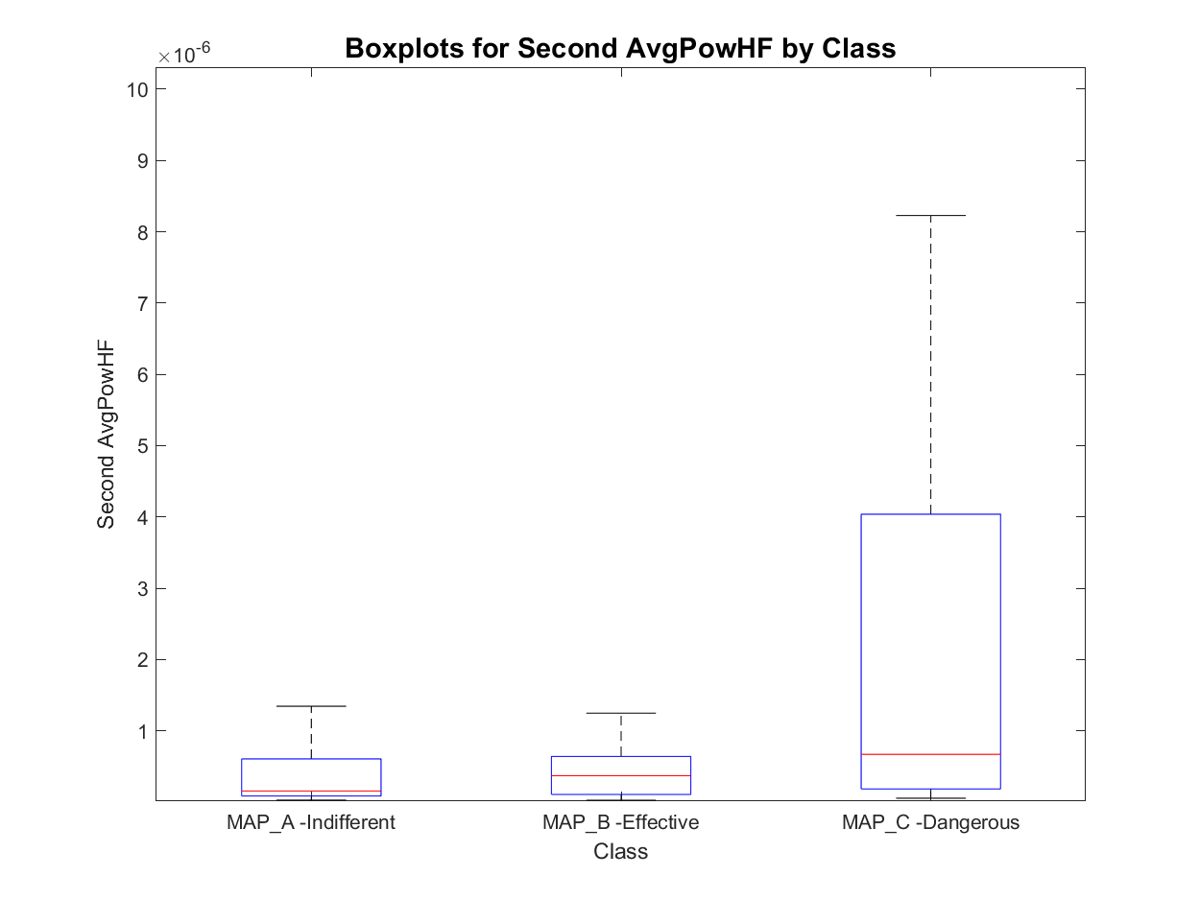
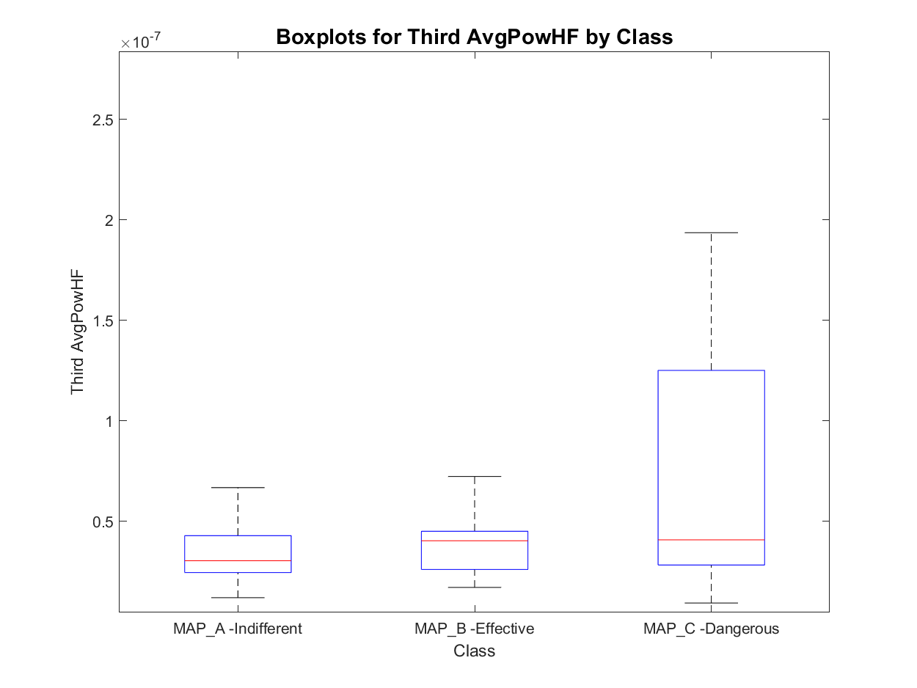
Features set 3.1: Avg HF Power of peaks
MAP_A has:
- 8 signals with one active area
- 452 signals with two active areas
- 180 signals with three active areas
- 23 signals with more than three active areas
total : 640
MAP_B has:
- 0 signals with one active area
- 67 signals with two active areas
- 26 signals with three active areas
- 1 signals with more than three active areas
total : 93
MAP_C has:
- 0 signals with one active area
- 20 signals with two active areas
- 62 signals with three active areas
- 8 signals with more than three active areas
total : 82
Order of magnitude
Order of occurrence

Slide 17
Outline
Feature extraction
Envelope features
Template matching features
Short time Fourier transformation features
Classification
Knowledge based classifier: recap
Improved Knowledge based classifier
Tree classifier: whole set of features optimal subset of features
Conclusions

Slide 18
Knowledge based classifier: recap
For each roving trace:
Divide the trace in three regions (Atrial: t<0.38s, His: 0.38<t<0.42 and Ventricular: 0.42<t<0.6);
Compute the absolute value of each region and find the maximum;
Then, apply the following rules:
KB V0: atrial peak thresholding
KB V1: atrial/ventricular ratio (Th: 05)
Is the His Peak above threshold?
No
Is the atrial peak > 0.5 mV?
No
Is the His Peak above threshold?
No
Is the atrial/ventricular peak ratio >threshold?
No
MAP B
MAP B
Yes
Yes
Yes
Yes
MAP C
MAP A
MAP C
MAP A

Slide 19
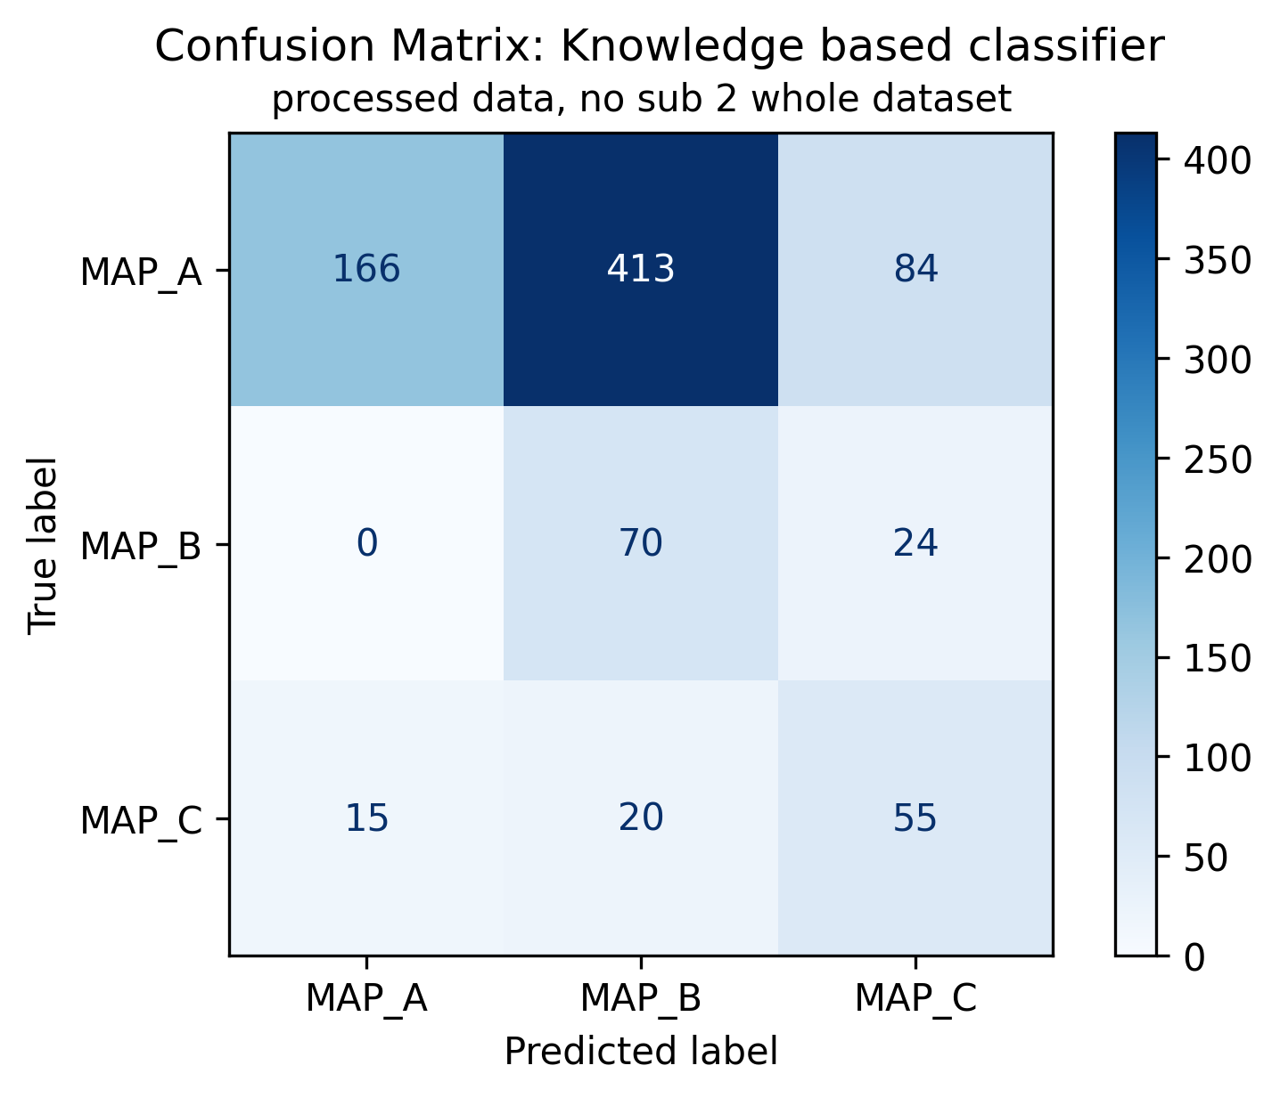
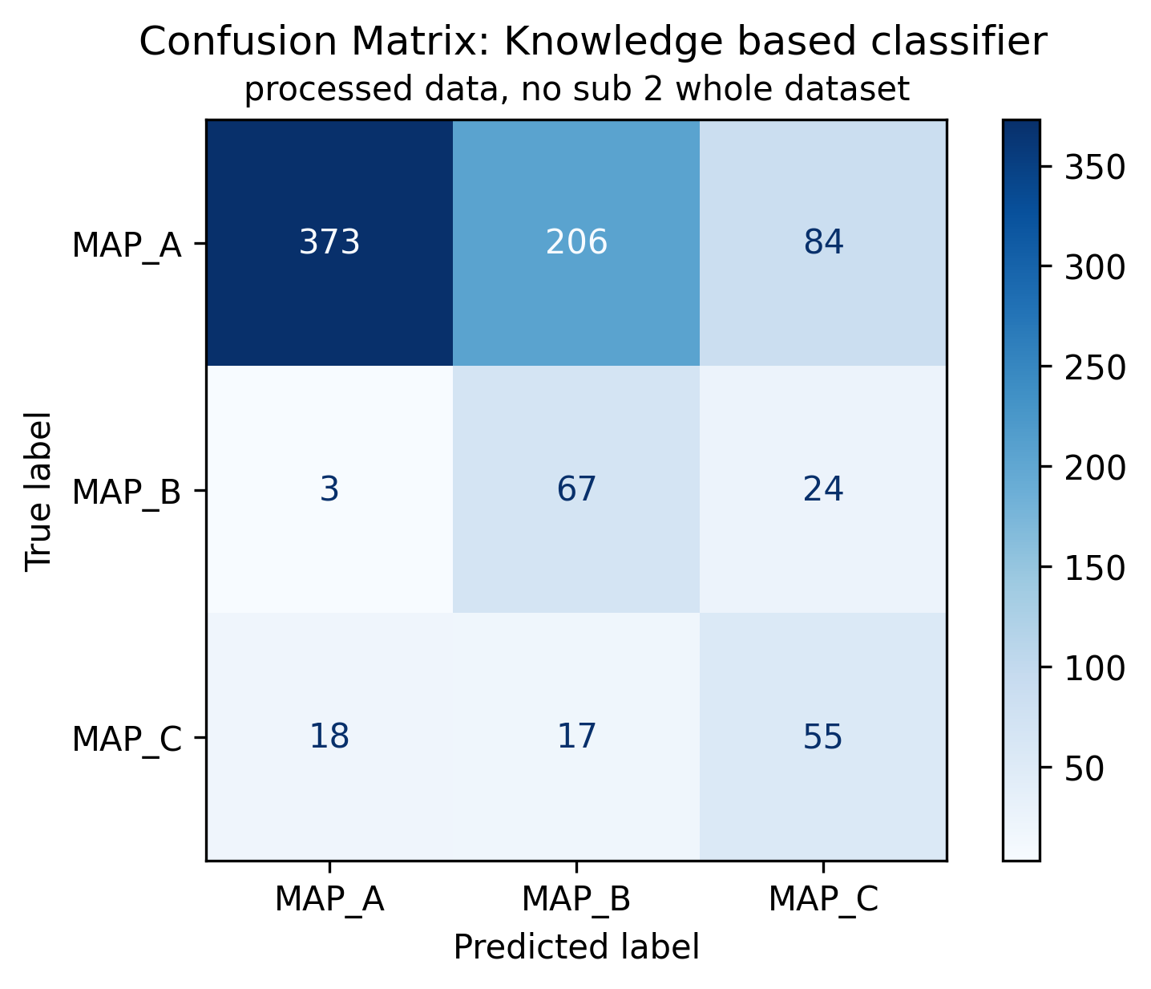
KB classifier V0 and V1: previous results
KB V1: atrial/ventricular ratio, th=0.5
KB V0: Atrial peak threshold
KB V1: atrial/ventricular ratio, th=0.5
Of 847 signals:
663 are ineffective (MAP A, 78.28%);
94 are effective (MAP B, 11.1%);
90 are dangerous (MAP C, 10.63%);

Slide 20
Outline
Feature extraction
Envelope features
Template matching features
Short time Fourier transformation features
Classification
Knowledge based classifier: recap
Improved Knowledge based classifier
Tree classifier: whole set of features optimal subset of features
Conclusions

Slide 21
Knowledge based classifier with envelope-based features
For each roving trace, evaluate the corresponding (active areas) features. Then:
KB V2: peaks thresholds and position
KB V3: peaks thresholds and atrial/ventricular
Is Minor_peak >0.020?
No
Is Dominant_peak_time <0.49
No
Is Minor_peak >0.021?
No
Is atrial_ventricular_ratio >0.2?
No
MAP B
MAP B
Yes
Yes
Yes
Yes
MAP C
MAP A
MAP C
MAP A

Slide 22
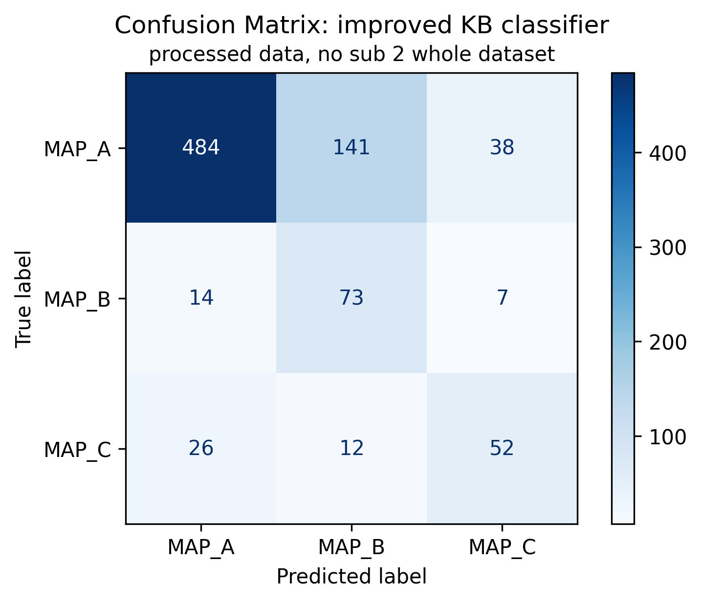

Knowledge based classifier with envelope-based features
KB V2: peaks thresholds and position
KB V2: peaks thresholds and position
KB V3: peaks thresholds and atrial/ventricular ratio
Of 847 signals:
663 are ineffective (MAP A, 78.28%);
94 are effective (MAP B, 11.1%);
90 are dangerous (MAP C, 10.63%);

Slide 23
Knowledge based classifier: comparison V2 (improved) and V1 (original)
KB V2: peaks thresholds and position
KB V1: atrial/ventricular ratio, th=0.5
KB V2: peaks thresholds and position
Respect to KB V1:
Higher precision and less misclassified MAP C and MAP B signals
Slightly increased number of misclassified signals from MAP C to MAP A and for MAP B to MAP A.
Of 847 signals:
663 are ineffective (MAP A, 78.28%);
94 are effective (MAP B, 11.1%);
90 are dangerous (MAP C, 10.63%);

Slide 24
Outline
Feature extraction
Envelope features
Template matching features
Short time Fourier transformation features
Classification
Knowledge based classifier: recap
Improved Knowledge based classifier
Tree classifier: whole set of features optimal subset of features
Conclusions

Slide 25


Machine learning approach: tree classifier
Machine learning approaches allow to model data with statistical models trained on a set of features.
Tree models are among the most easily explained, therefore the choice felt on them.
Mathematical rules are defined into each node to minimize the impurity of the following level
An “impurity measure” is required
Tuning the depth of the three is required
LOPOCV is used as validation technique
Tree classifiers
Tree 1: whole feature set
Tree 2: relevant feature set
Impurity measure: Cross entropy
Impurity measure: Cross entropy
Depth: maximising weighted f1 score
Depth: maximising weighted f1 score
Cross entropy definition
$$H\left(p\right)=−\sum_{i=1}^{N_{class}}{p_{i}\log\left(p_{i}\right)}$$
Weighted F1 score definition
$$F_{1, weighted}=\sum_{i=1}^{N_{class}}{w_{i}F_{1,i} } where w_{i}=\frac{\# samples class i}{\# total samples}$$

Slide 26
Feature selection: correlation matrix
To avoid the usage of features correlated between each other, correlation matrix has been computed.
Prior to classification, some features have been re moved according to the correlation matrix:
Envelope peaks values and time
silent_rateo
cross_energy

Slide 27


Tree classifier V1: results
Tree 1: whole feature set
Of 847 signals:
663 are ineffective (MAP A, 78.28%);
94 are effective (MAP B, 11.1%);
90 are dangerous (MAP C, 10.63%);

Slide 28


Tree classifier V2 – subset of features: results
Tree 2: relevant features set
Of 847 signals:
663 are ineffective (MAP A, 78.28%);
94 are effective (MAP B, 11.1%);
90 are dangerous (MAP C, 10.63%);

Slide 29



SHAP analysis on feature subset

Slide 30
Tree classifiers: LOPOCV confusion matrix comparison
Tree 1: whole feature set
Tree 2: relevant feature subset
Of 847 signals:
663 are ineffective (MAP A, 78.28%);
94 are effective (MAP B, 11.1%);
90 are dangerous (MAP C, 10.63%);

Slide 31

Knowledge based or tree?
Improved KB V0: peaks thresholds and position
Tree 2: relevant feature subset

Slide 32
Outline
Feature extraction
Envelope features
Template matching features
Short time Fourier transformation features
Classification
Knowledge based classifier: recap
Improved Knowledge based classifier
Tree classifier: whole set of features optimal subset of features
Conclusions

Slide 33
Conclusions
Two feature extraction pipelines based on envelope analysis and template matching have proposed:
Envelope features provides information on peaks positions and active areas of the signal
Template matching features provides information on signal morphology
Moreover, STFT usage has been explored but features have not been evaluated for the time being as they would have to be meticulously defined from scratch. Otherwise, redundant information would be introduced.
Other similar studies used DWT based features (similar to the one introduced with TM), autocorrelation-based features, self-similarity features and complexity-analysis based features.
Then, three models have been evaluated:
An improved Knowledge based model based on envelope features
A decision tree (LOPO cross validation) trained onto the whole feature set
A decision tree (LOPOCV) trained onto an optimized feature set
Results are encouraging but higher performance are required, specially into MAP A/MAP B discrimination.
Future steps could be:
Defining new features based on a second template (more complex)
Computing new features as envelope peaks area, ApEN, Mutual Information
Defining and analyzing spectral/STFT features

